Slide 1



# AWS Account Creation # EMR Spark Cluster # S3 Storage # Delete data in S3 # Terminate all Clusters

Slide 2
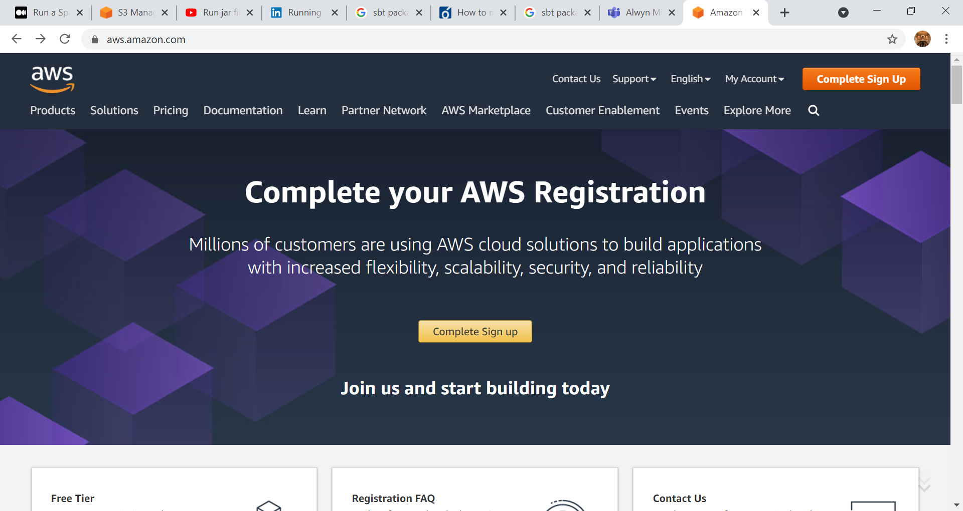

Slide 3

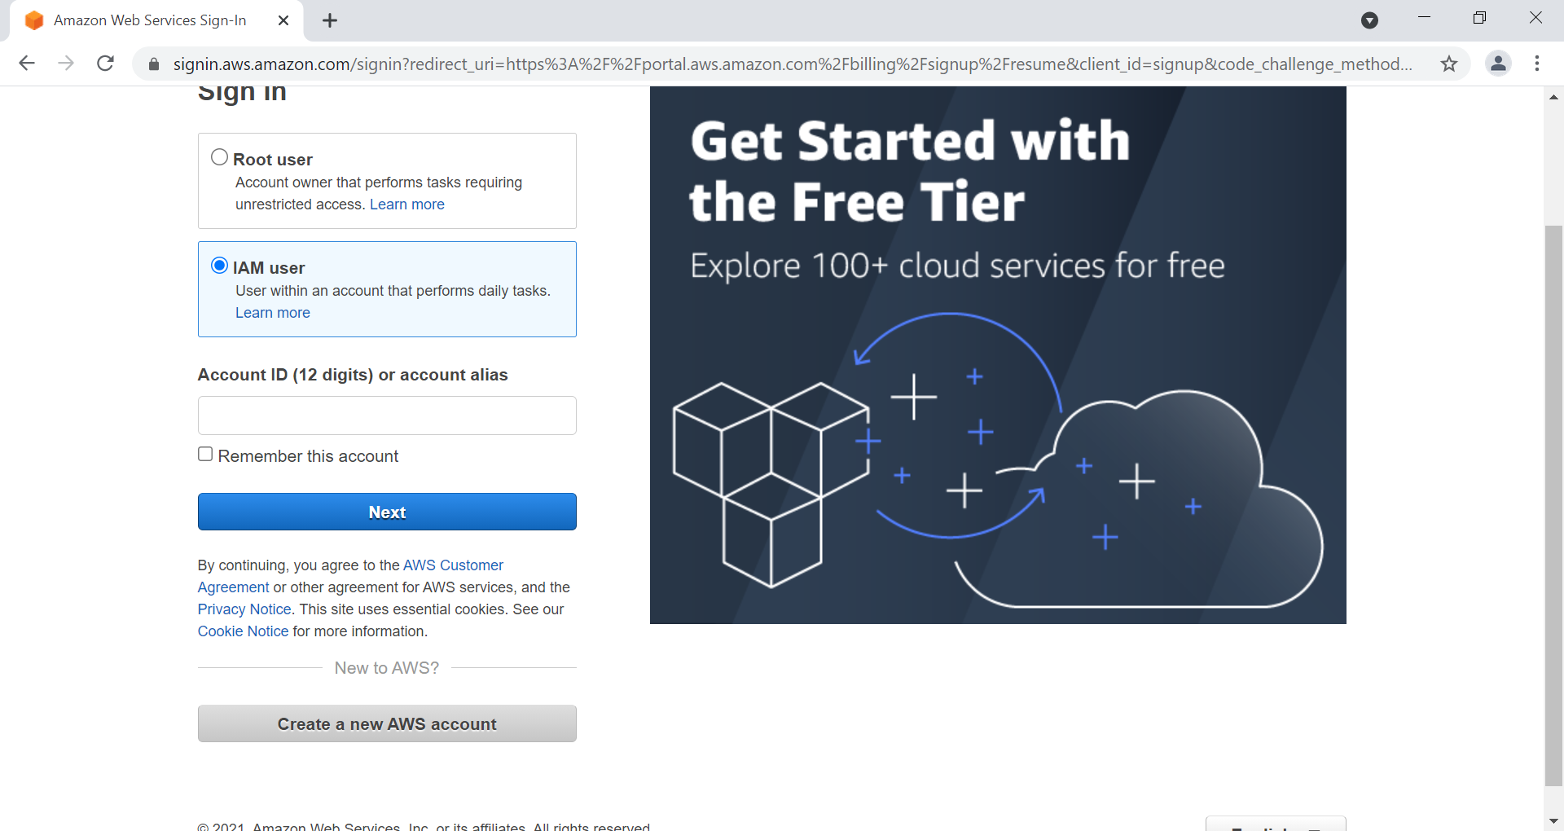

Slide 4
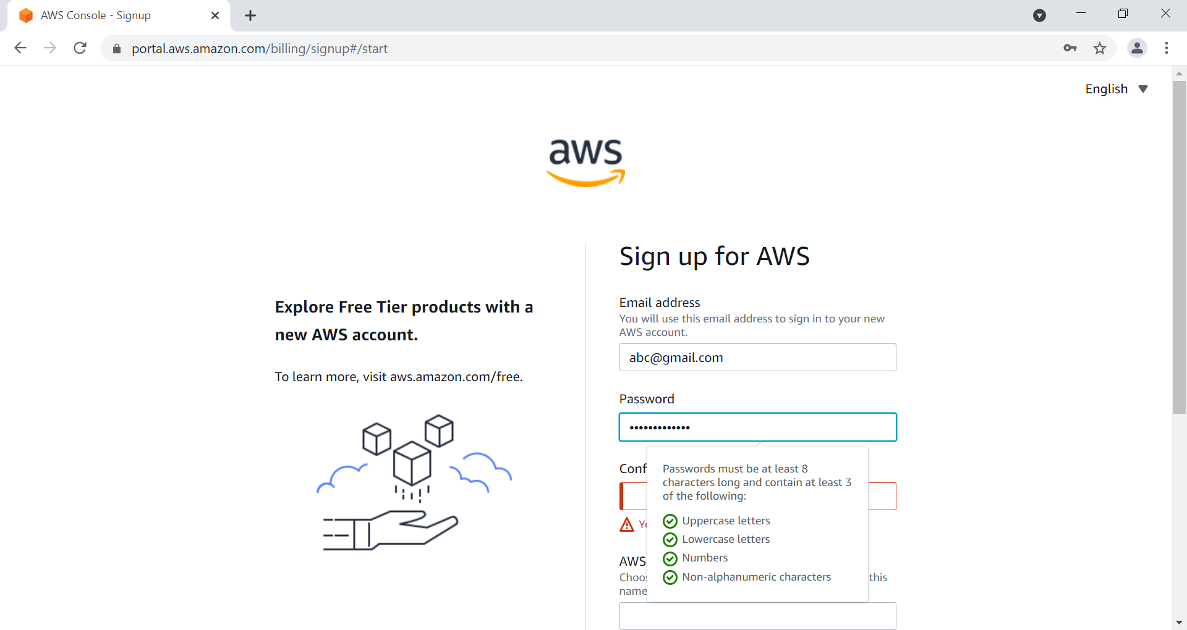

Slide 5
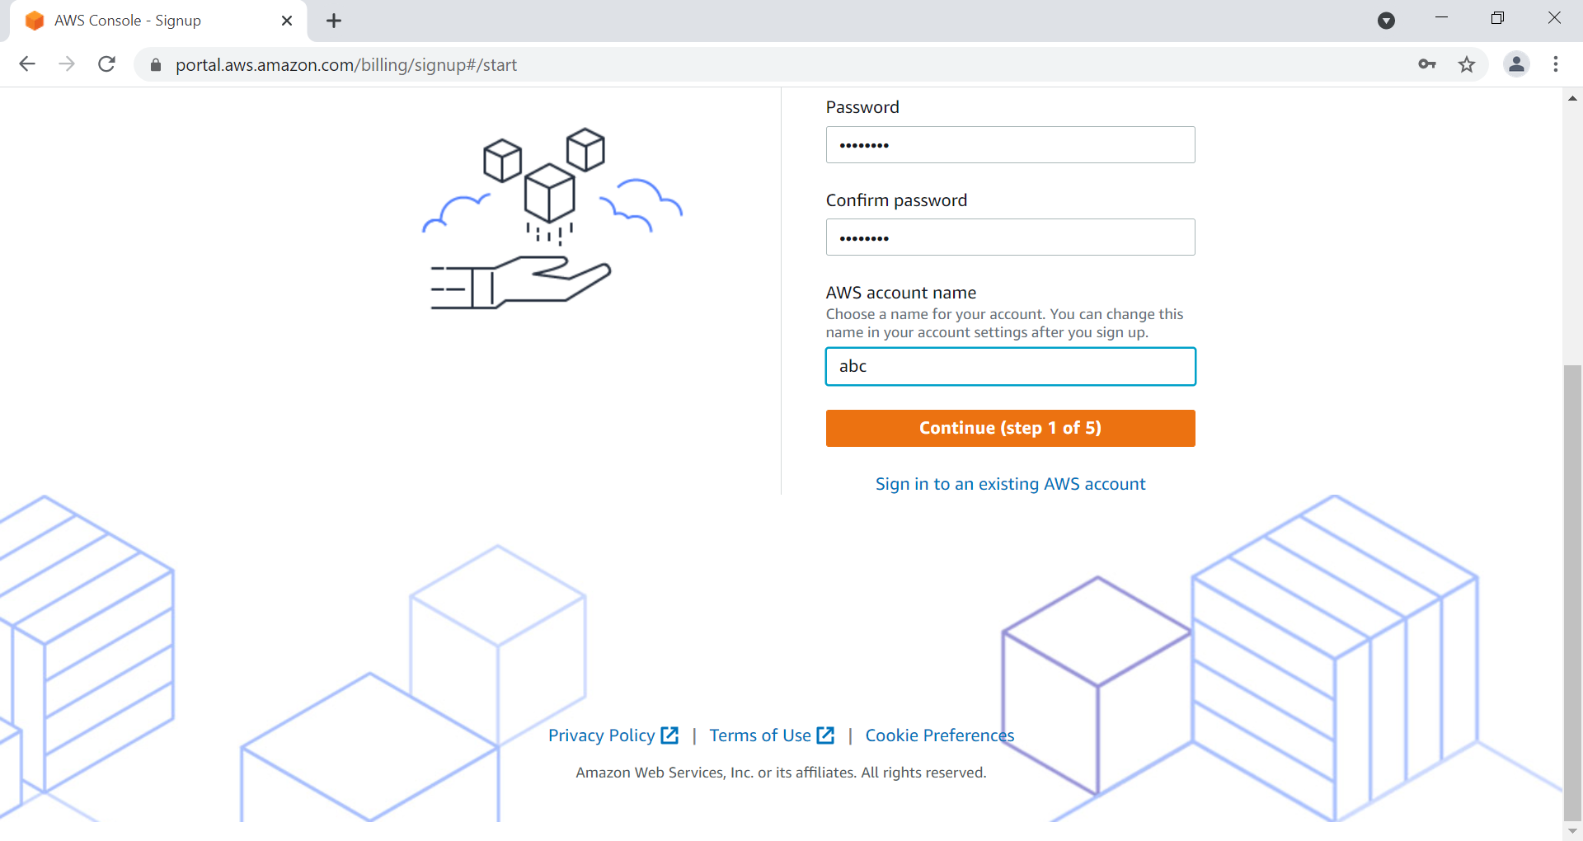

Slide 6
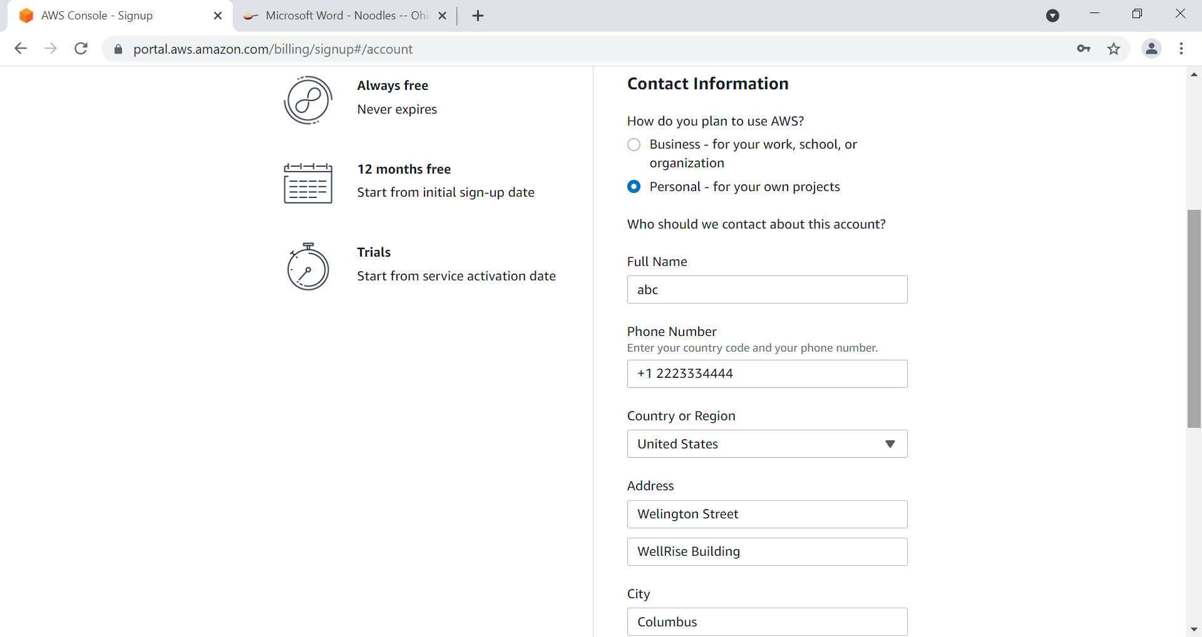

Slide 7
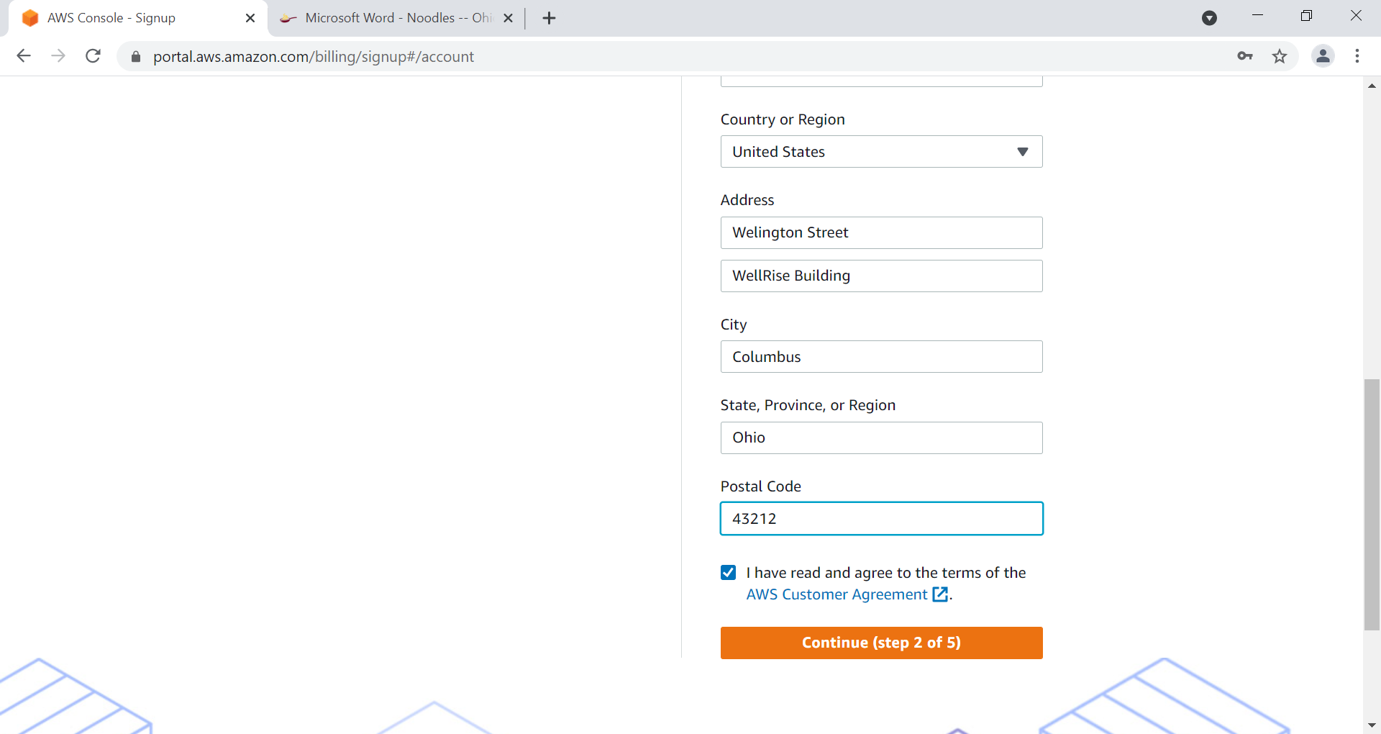

Slide 8
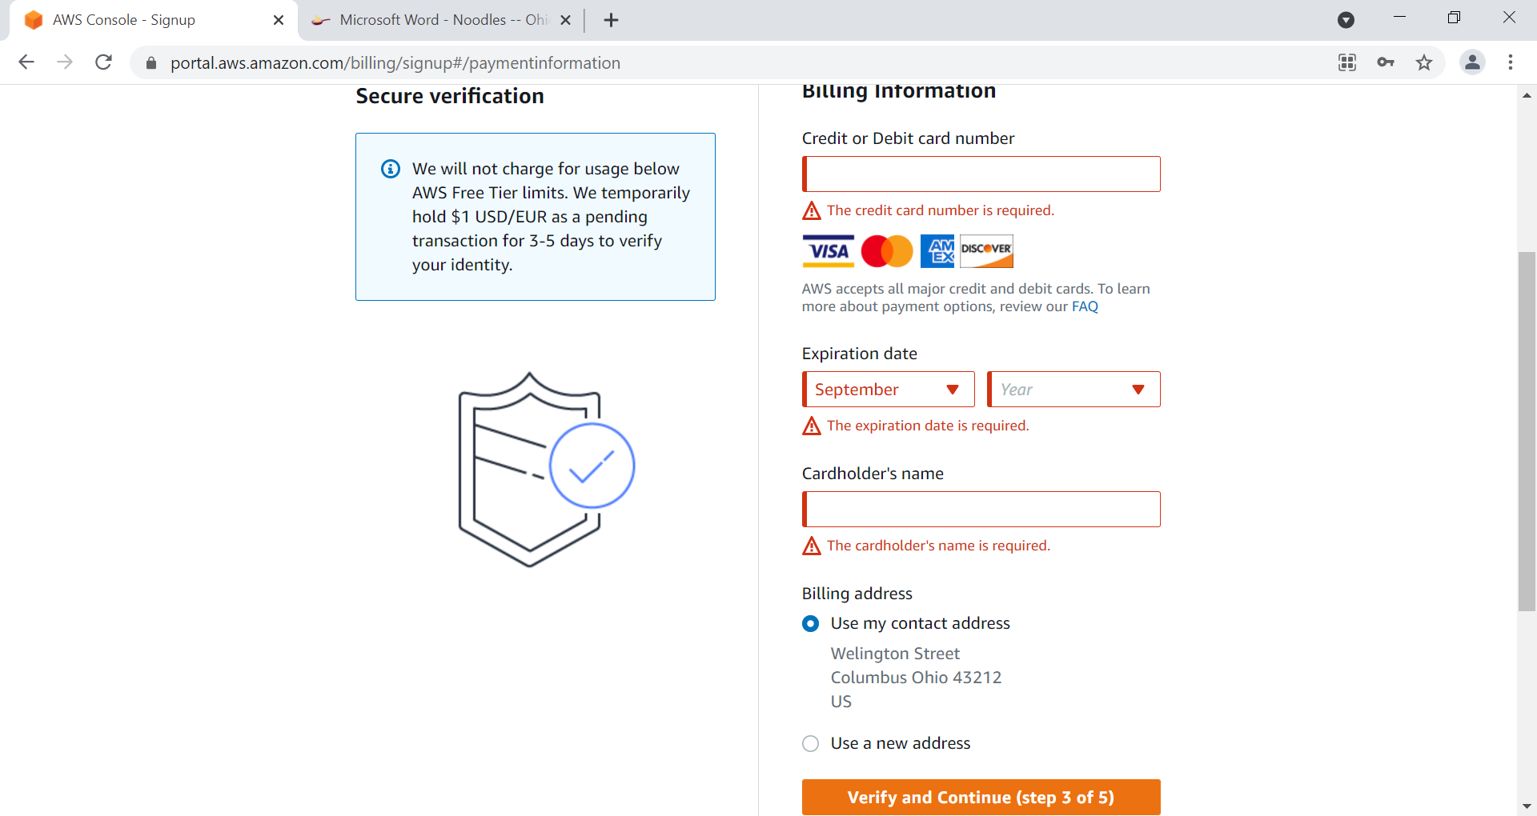

Slide 9
After SignUp - Relogin

Slide 10
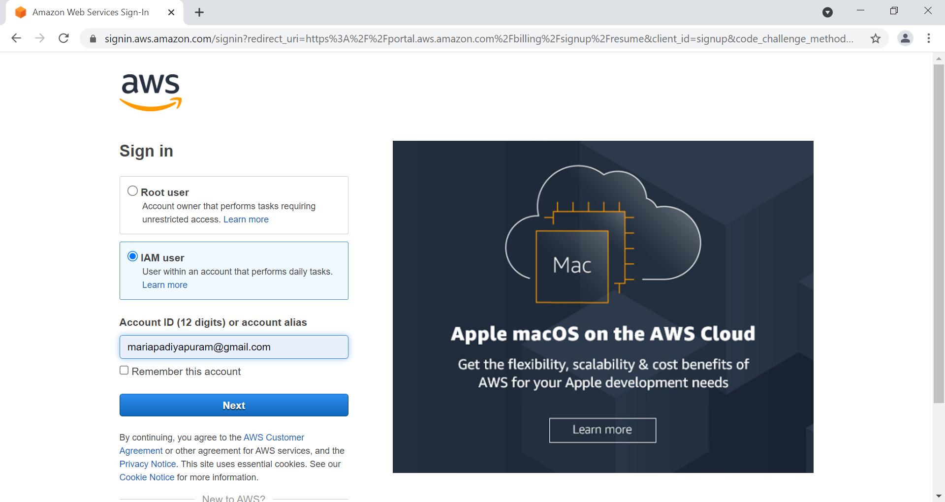

Slide 11
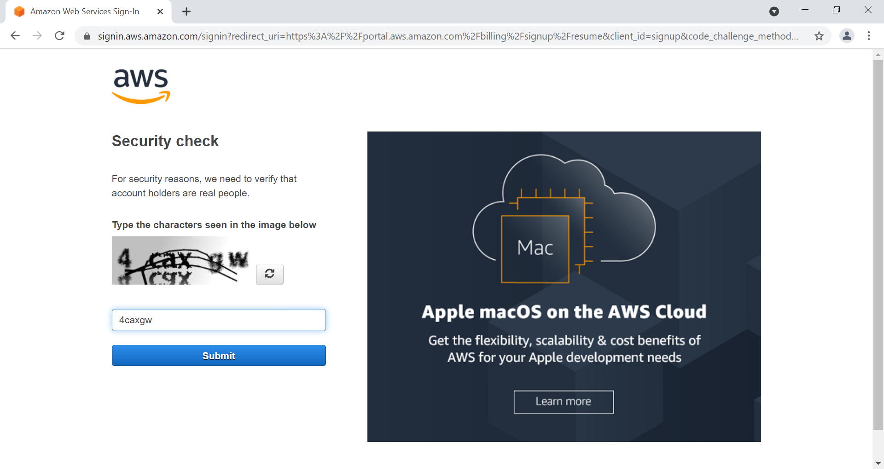

Slide 12
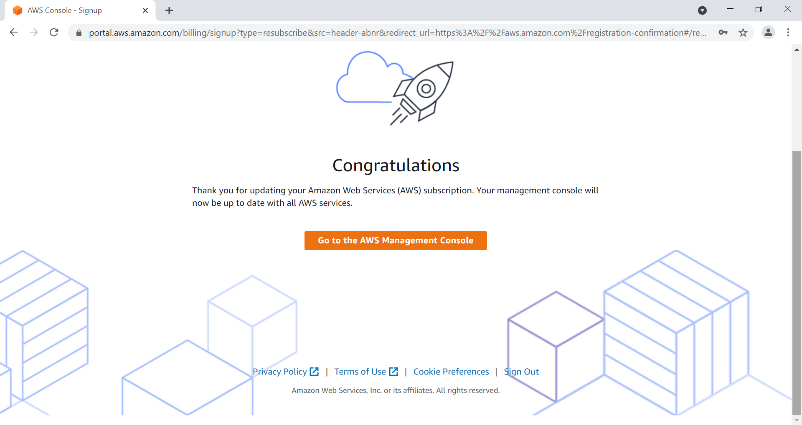

Slide 13
Click on AWS Management Console

Slide 14
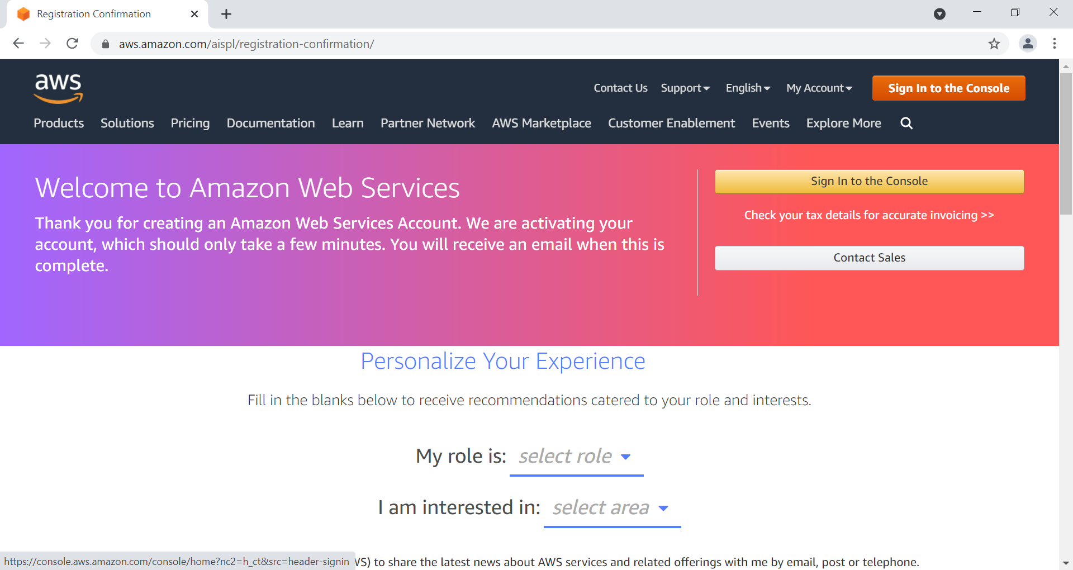

Slide 15
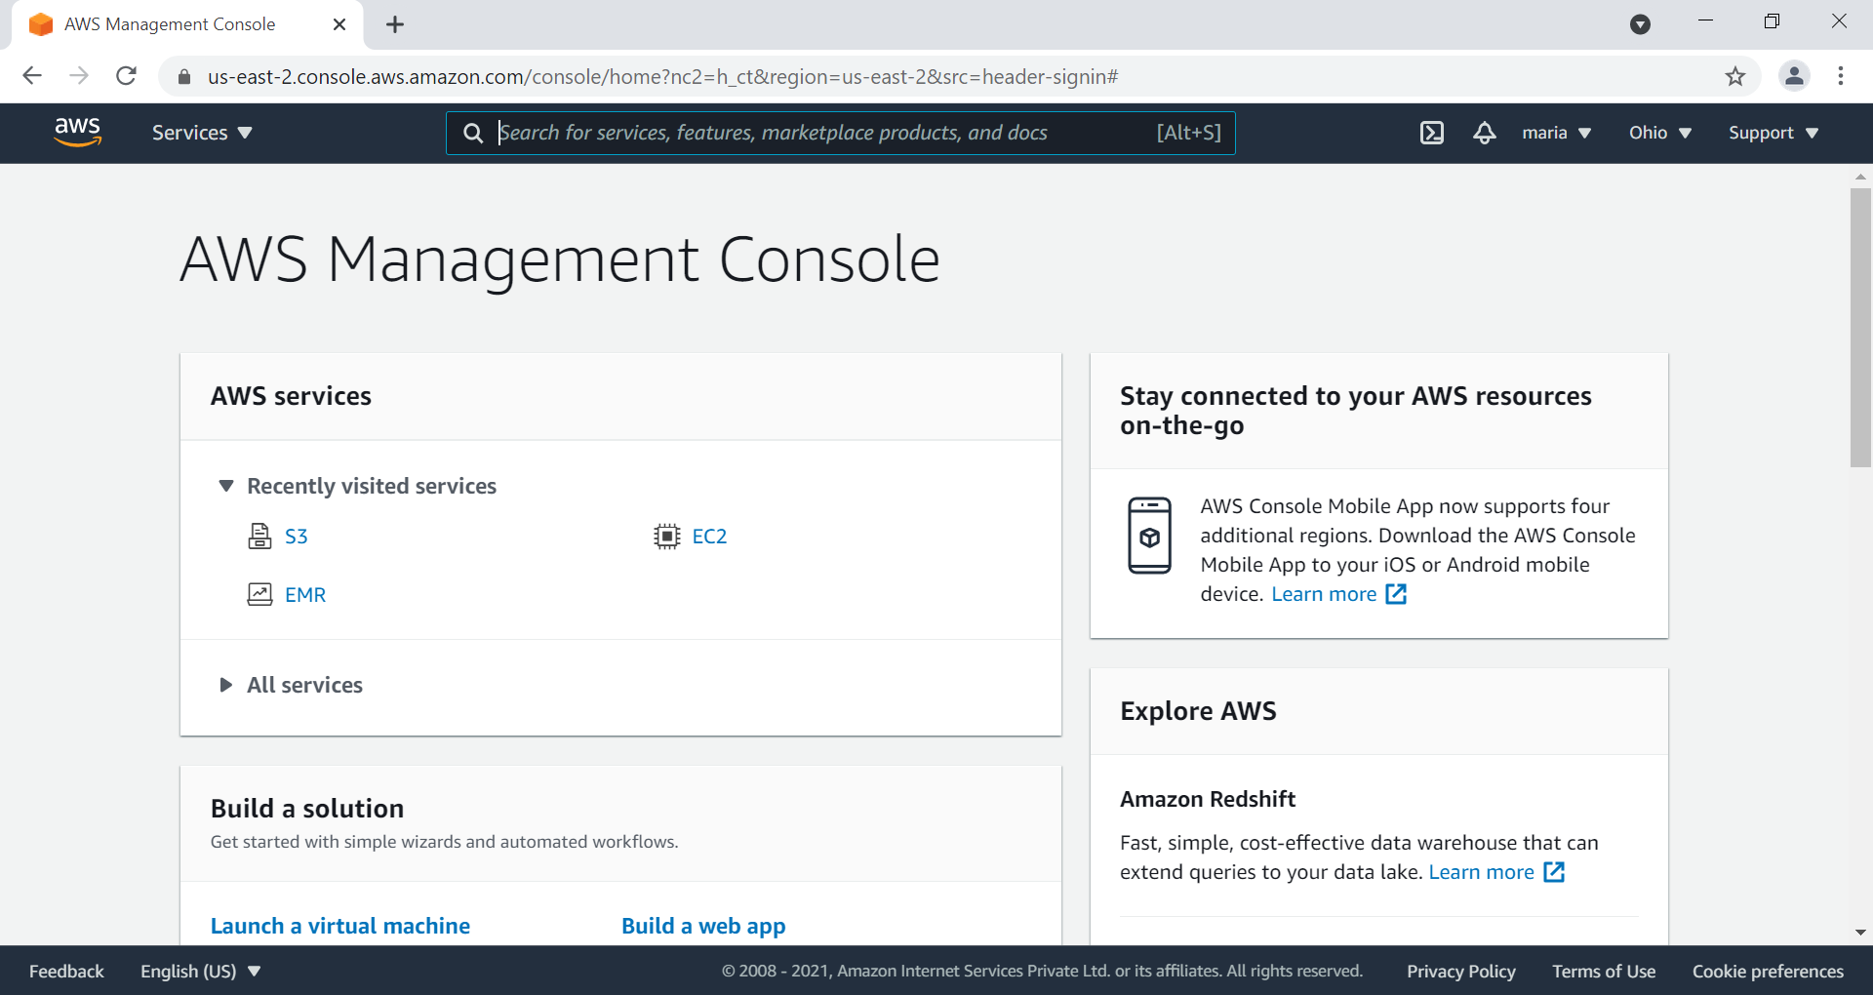

Slide 16
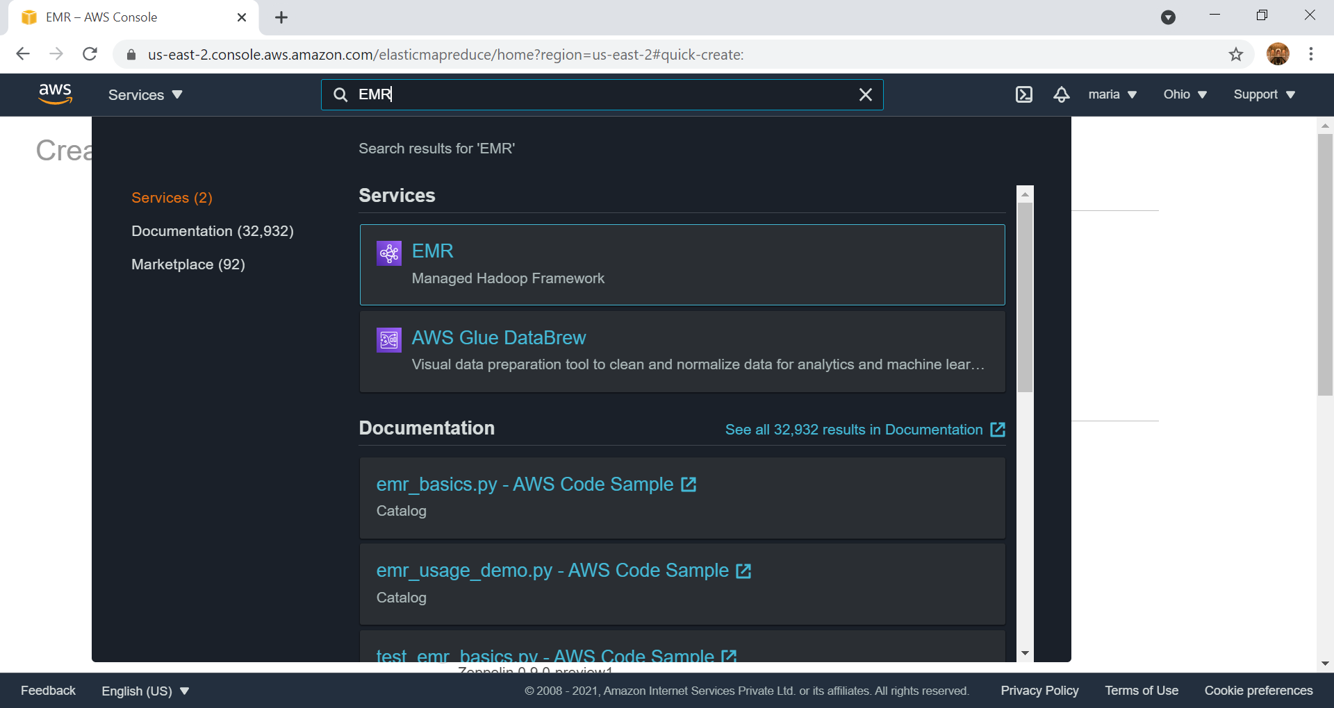

Slide 17
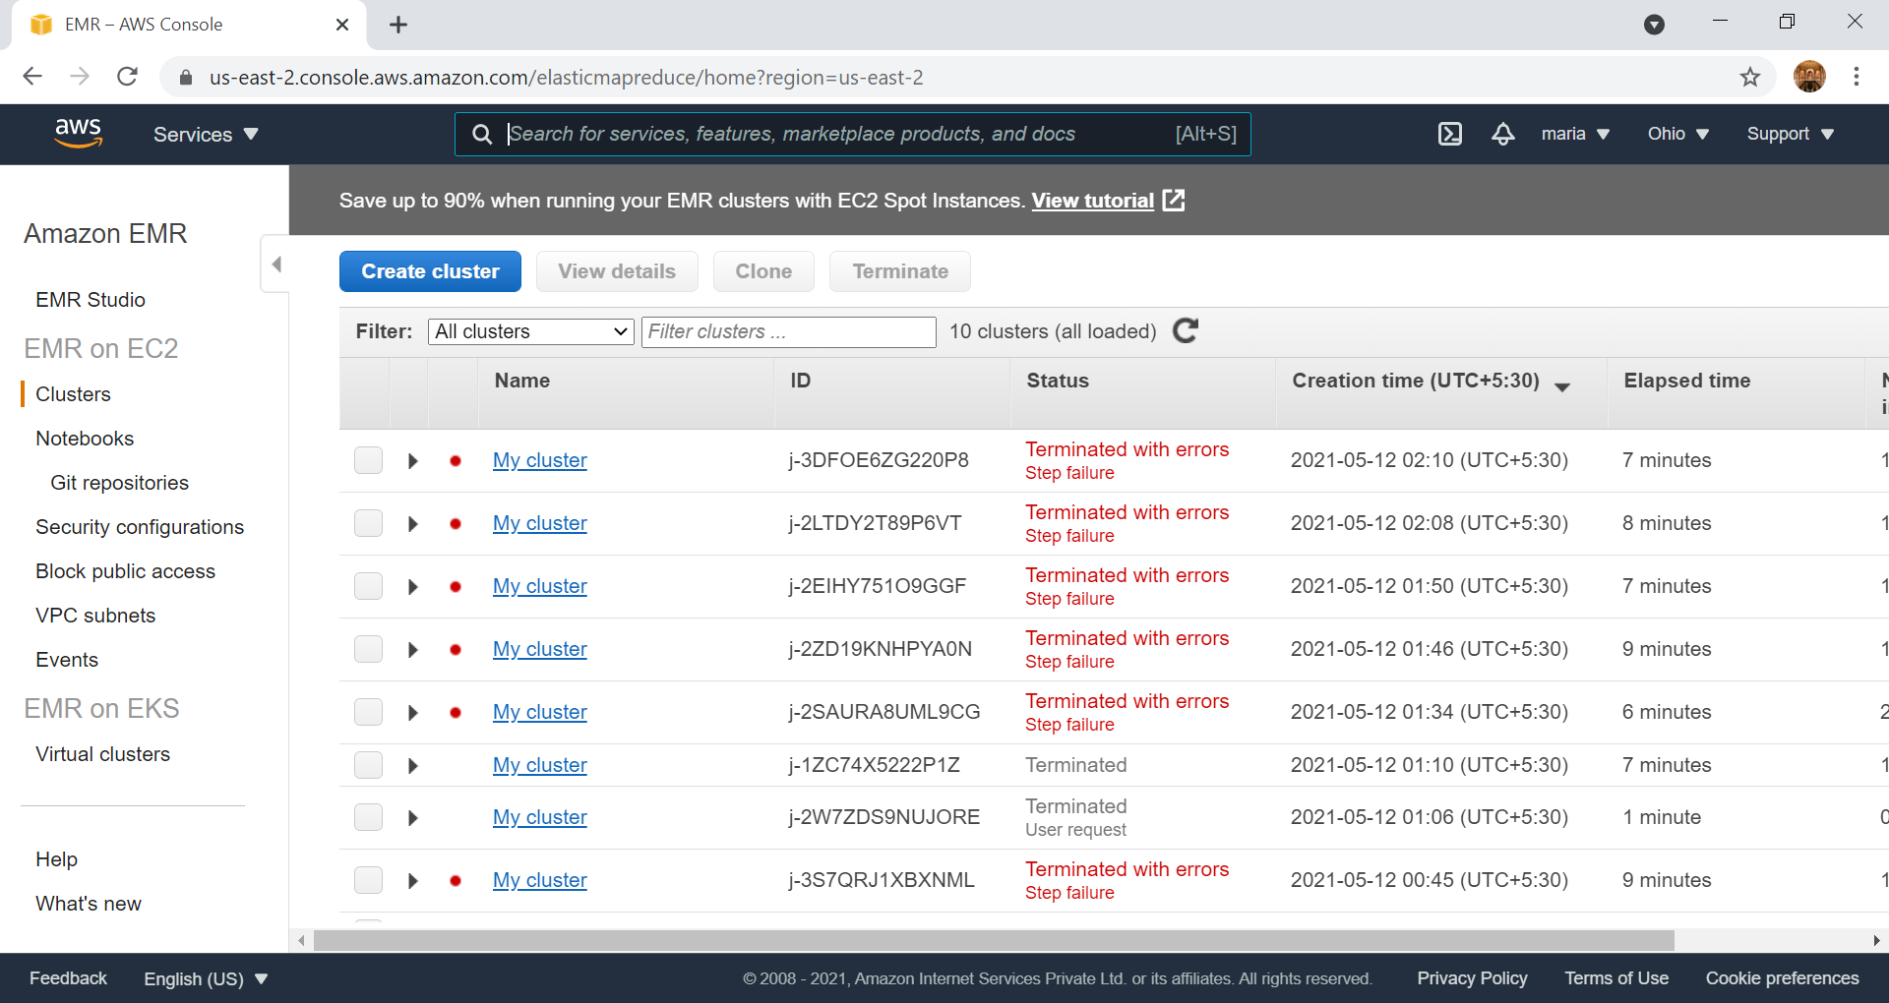

Slide 18
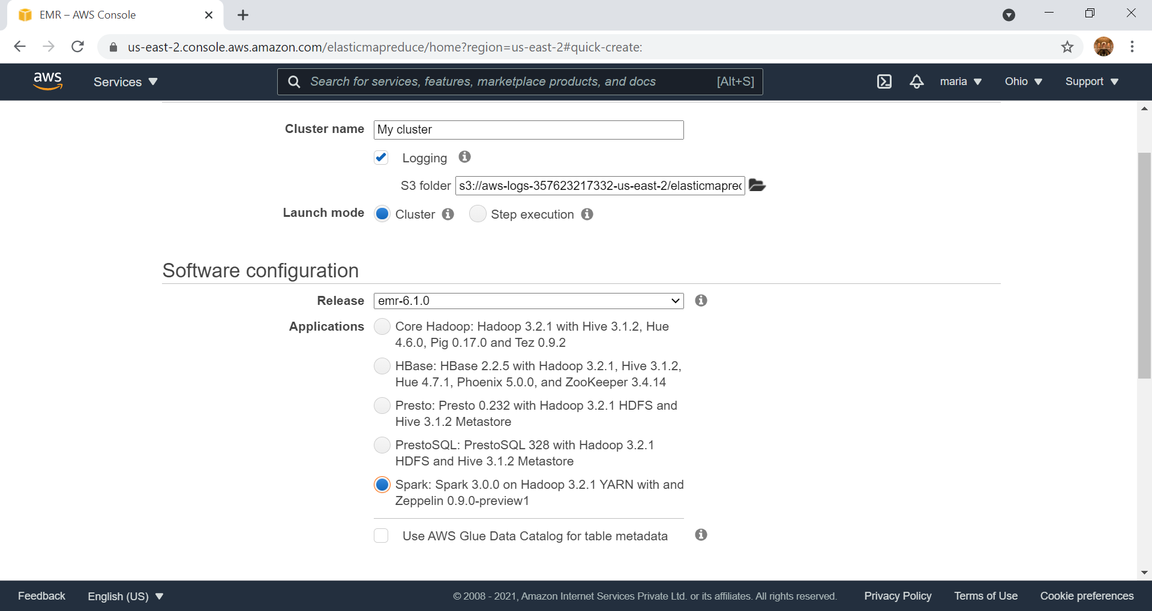

Slide 19
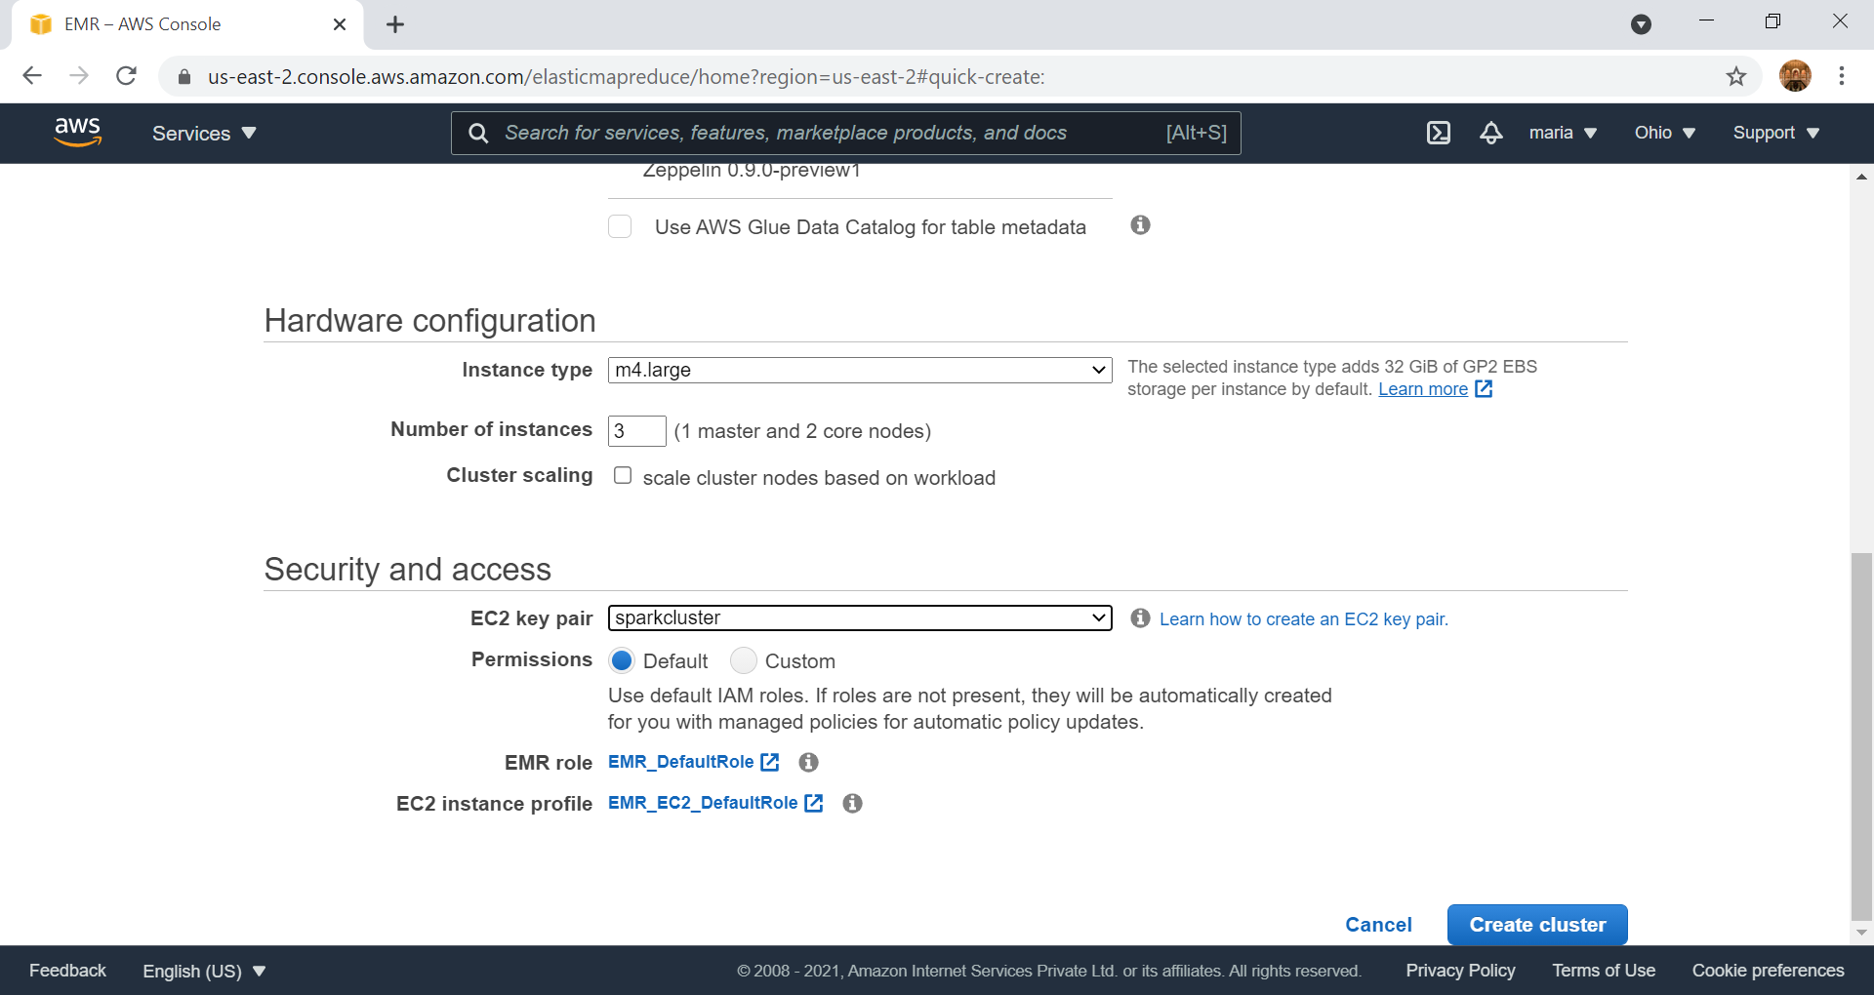

Slide 20
Create EC2 Key pair

Slide 21
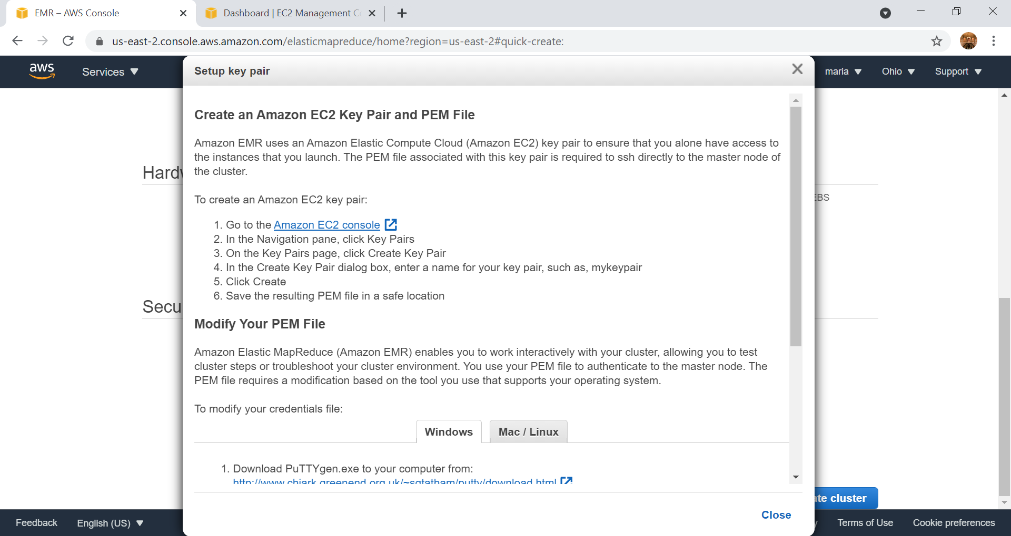

Slide 22
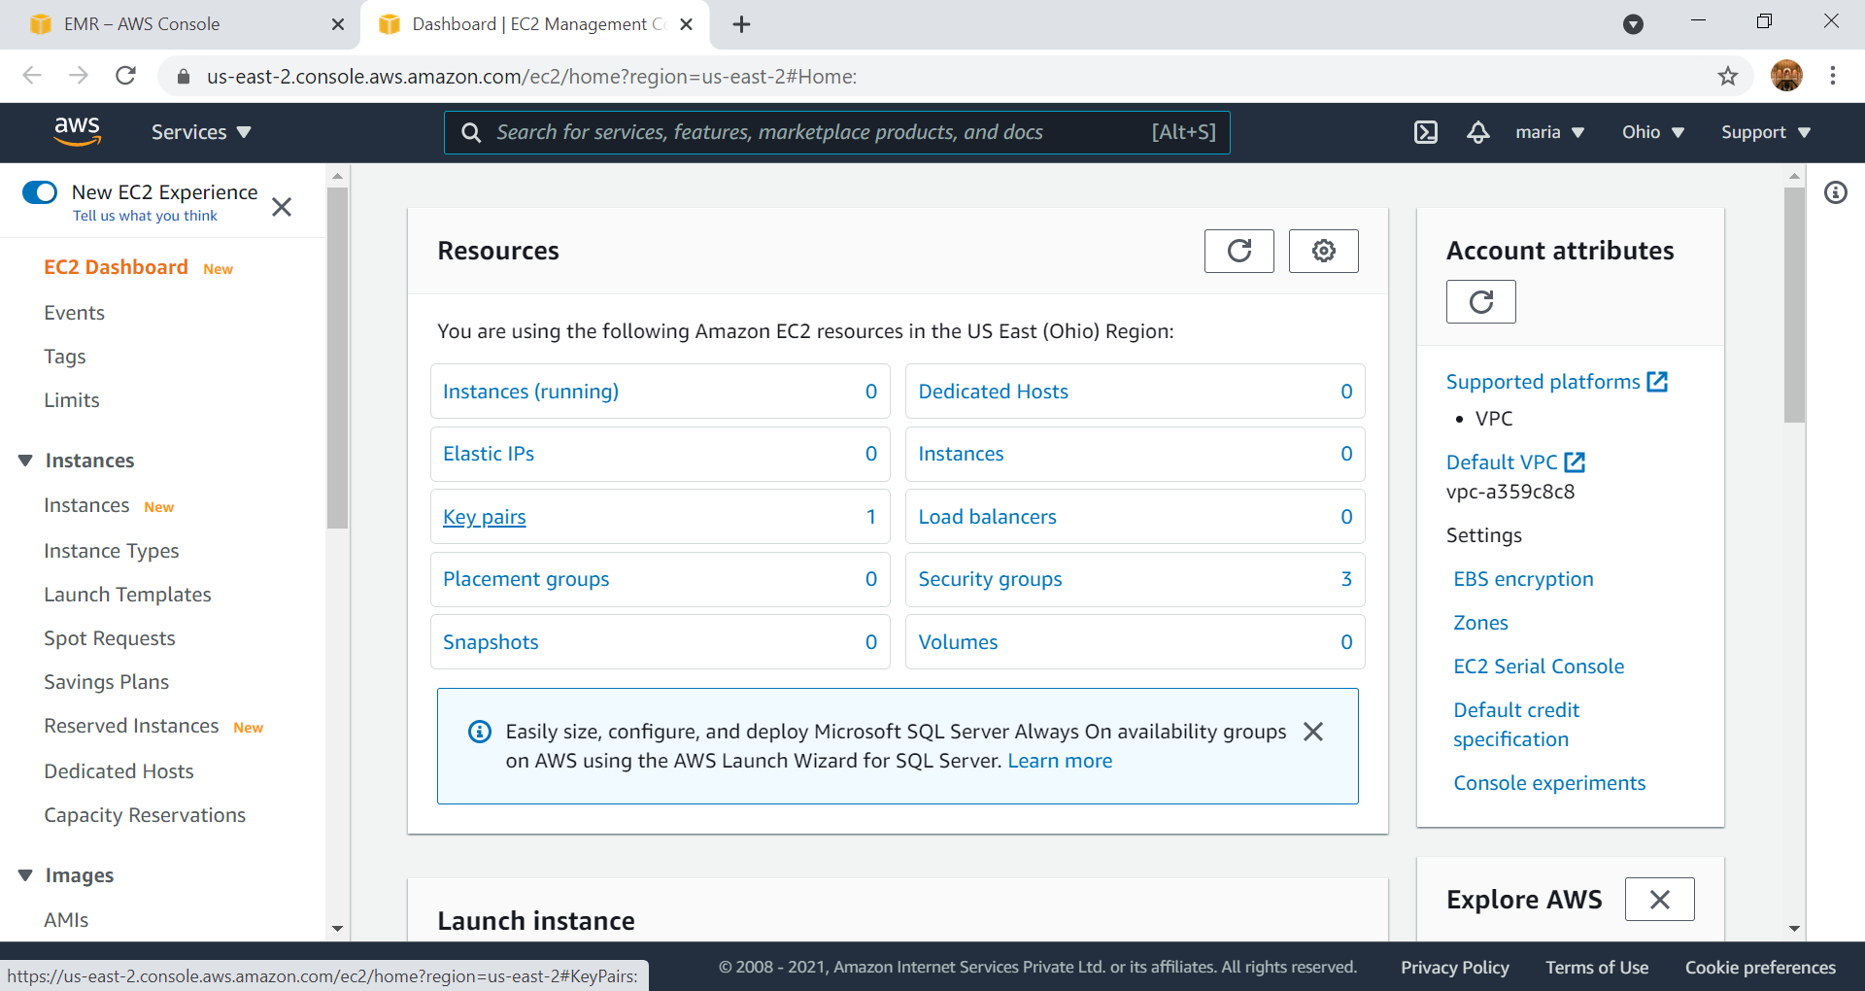

Slide 23
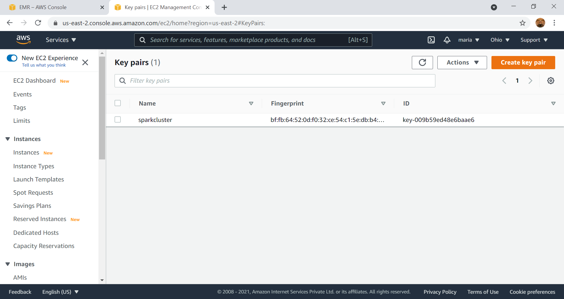

Slide 24
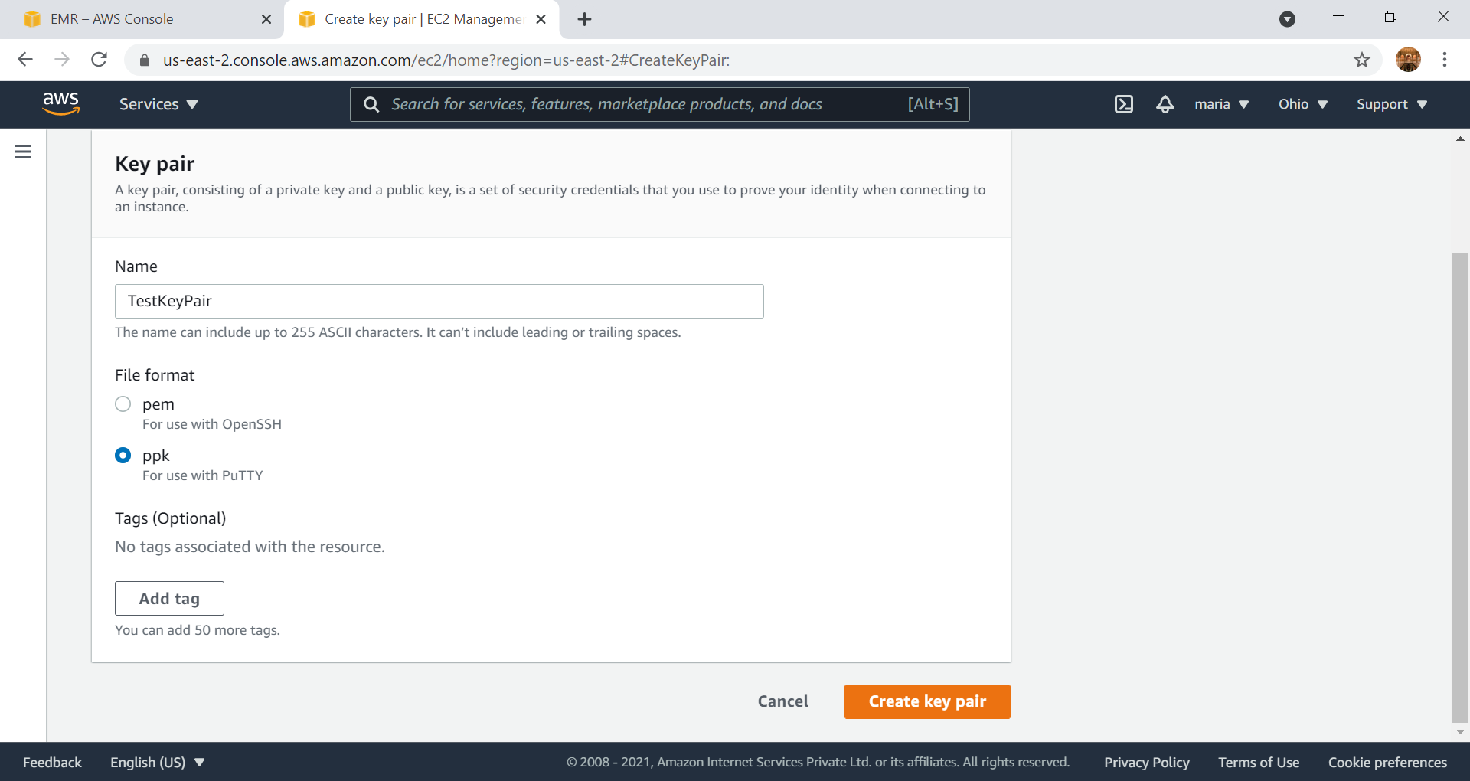

Slide 25
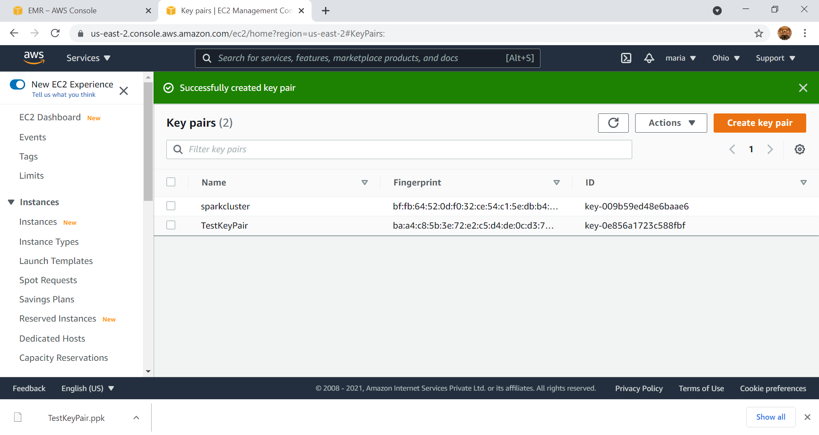

Slide 26
Start Cluster

Slide 27
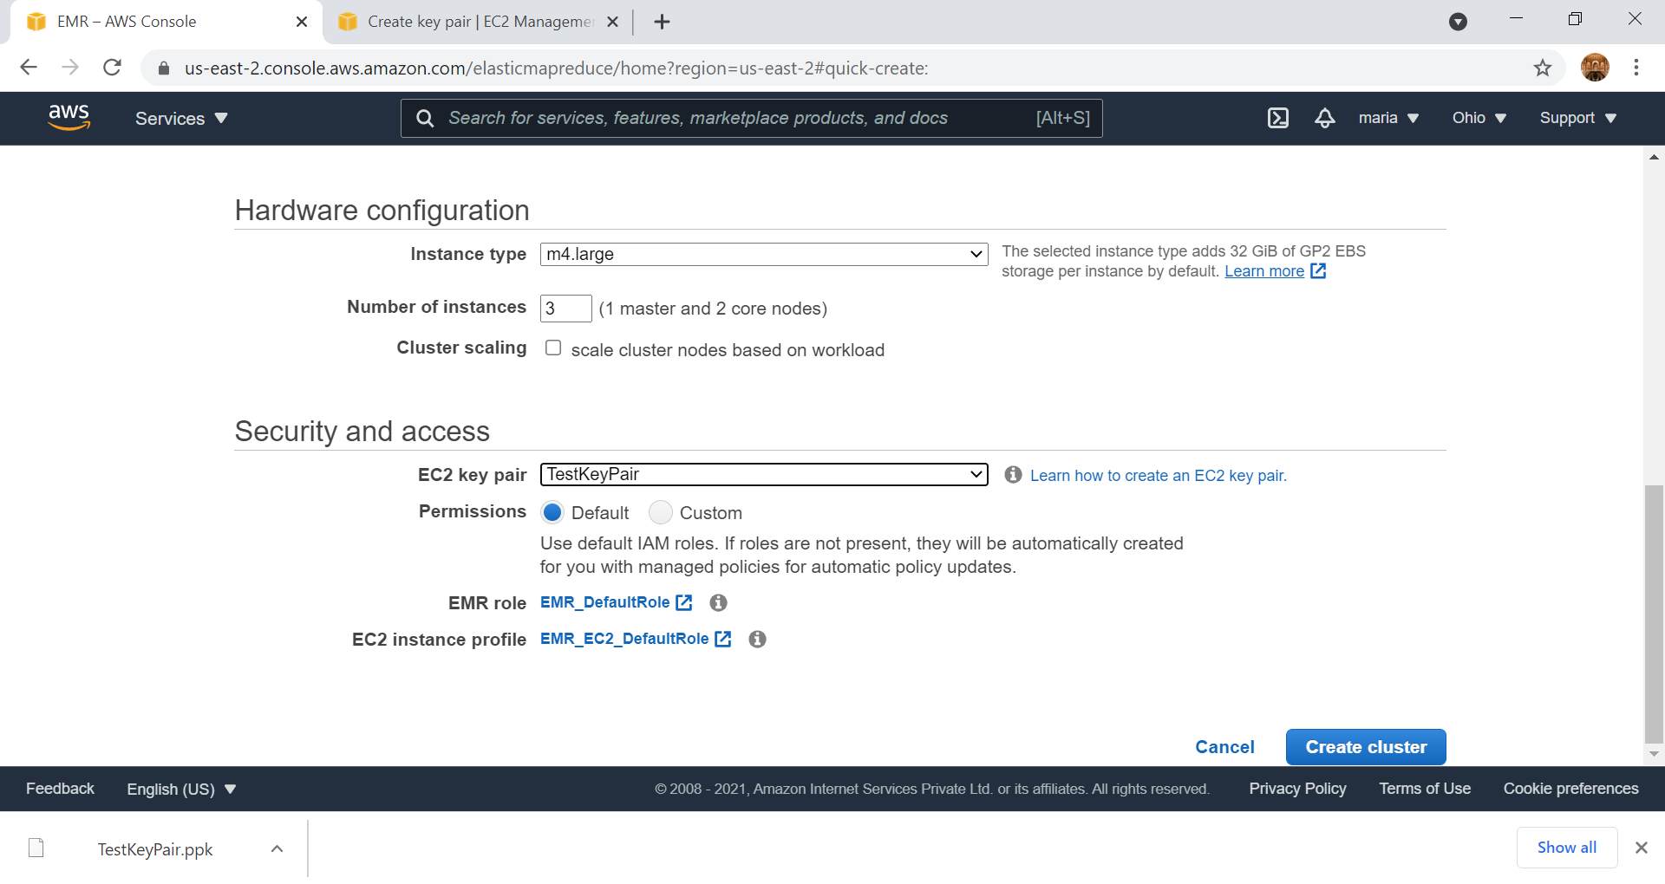

Slide 28
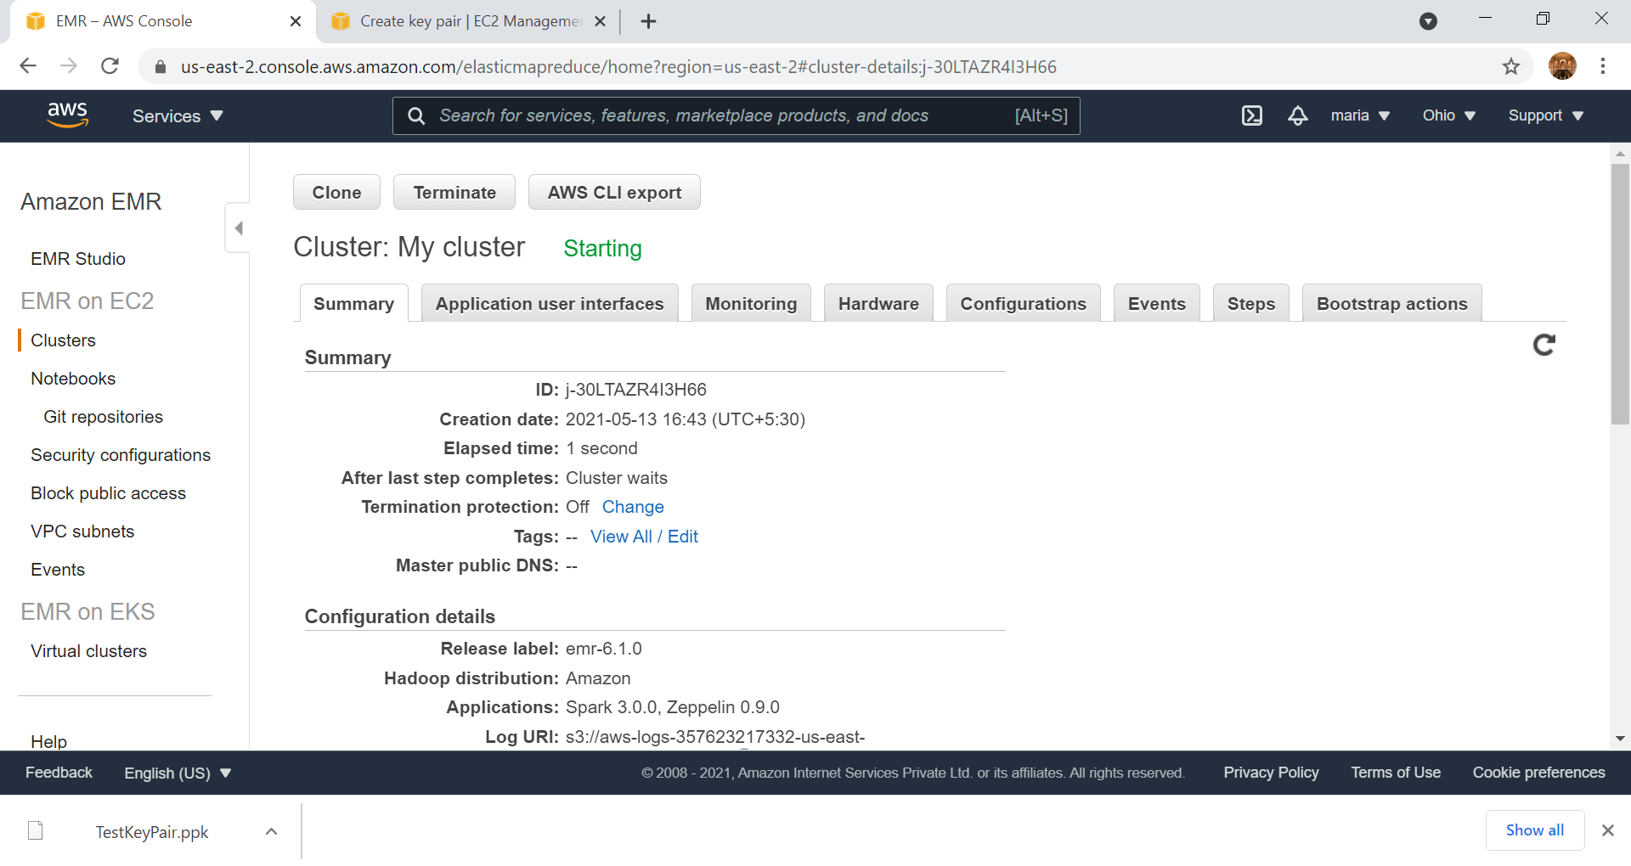

Slide 30
HelloSpark
Print in AWS EMR

Slide 31
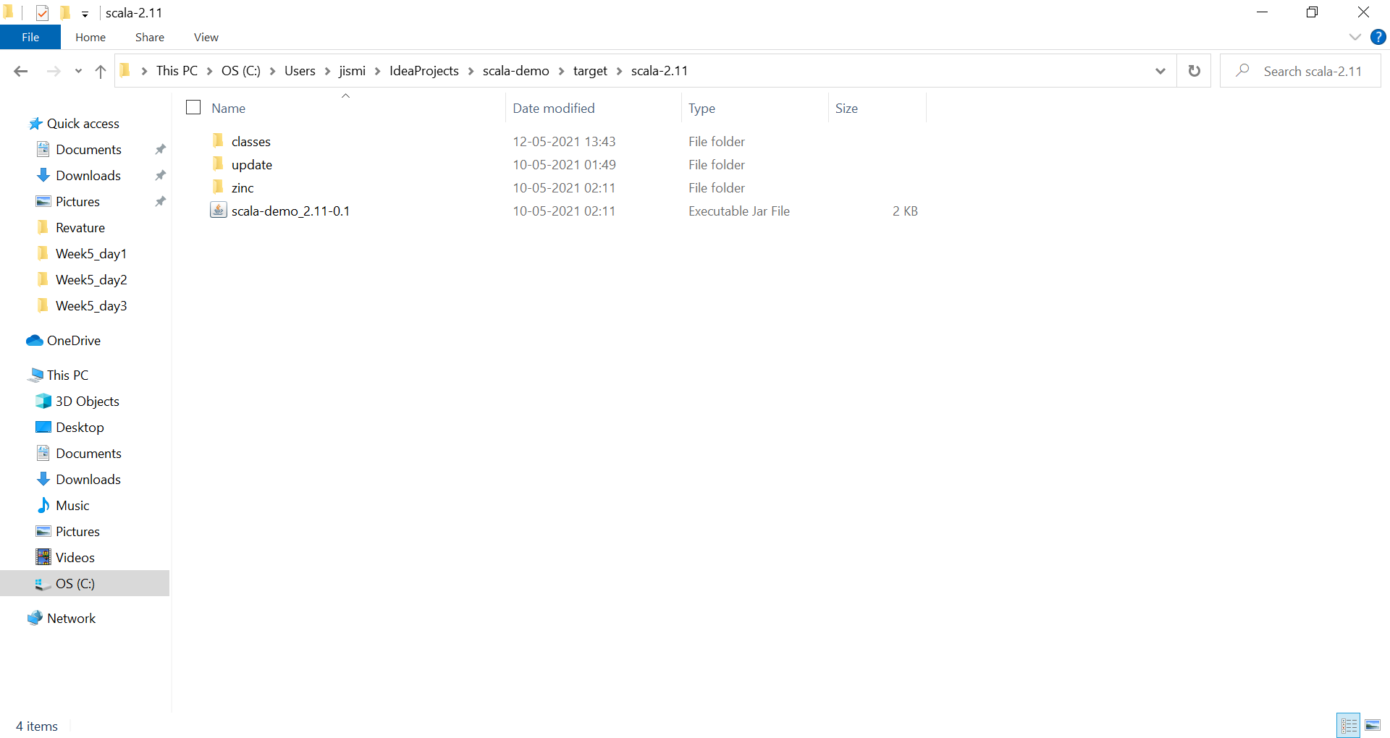
Jar Location

Slide 32
Create a Bucket in S3
Create a Folder
Upload the JAR file in S3

Slide 33
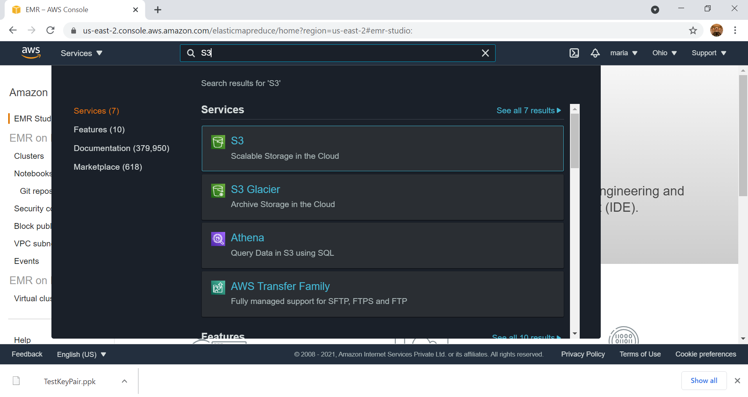

Slide 34
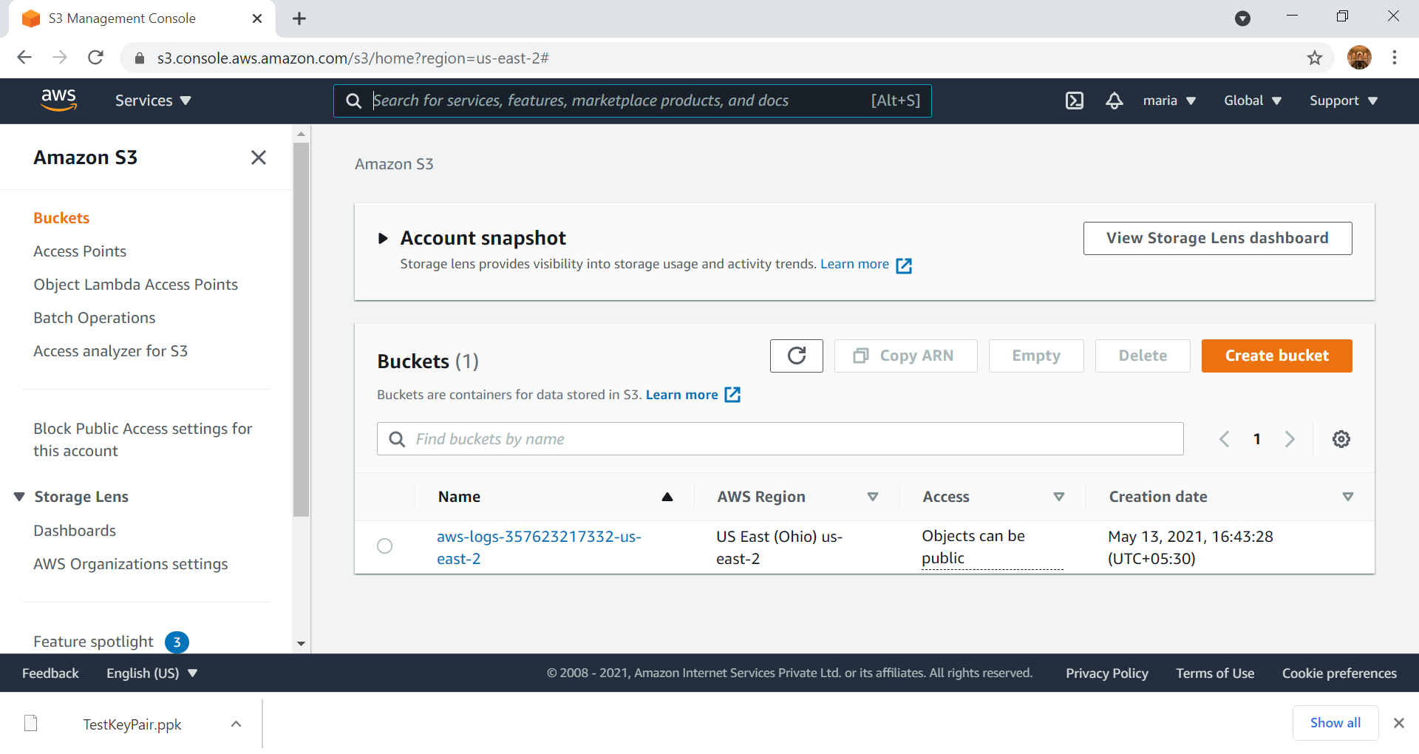

Slide 35
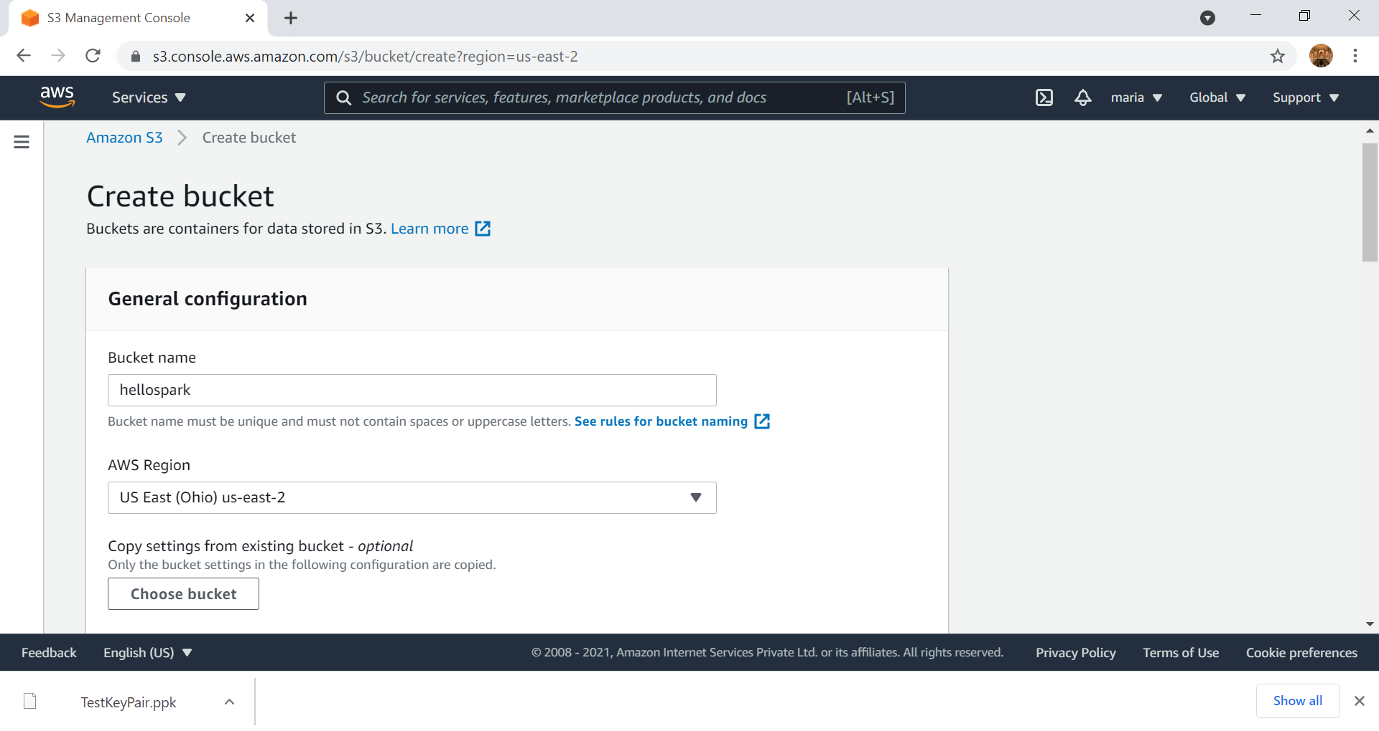
Choose the region with lowest cost/hr

Slide 36
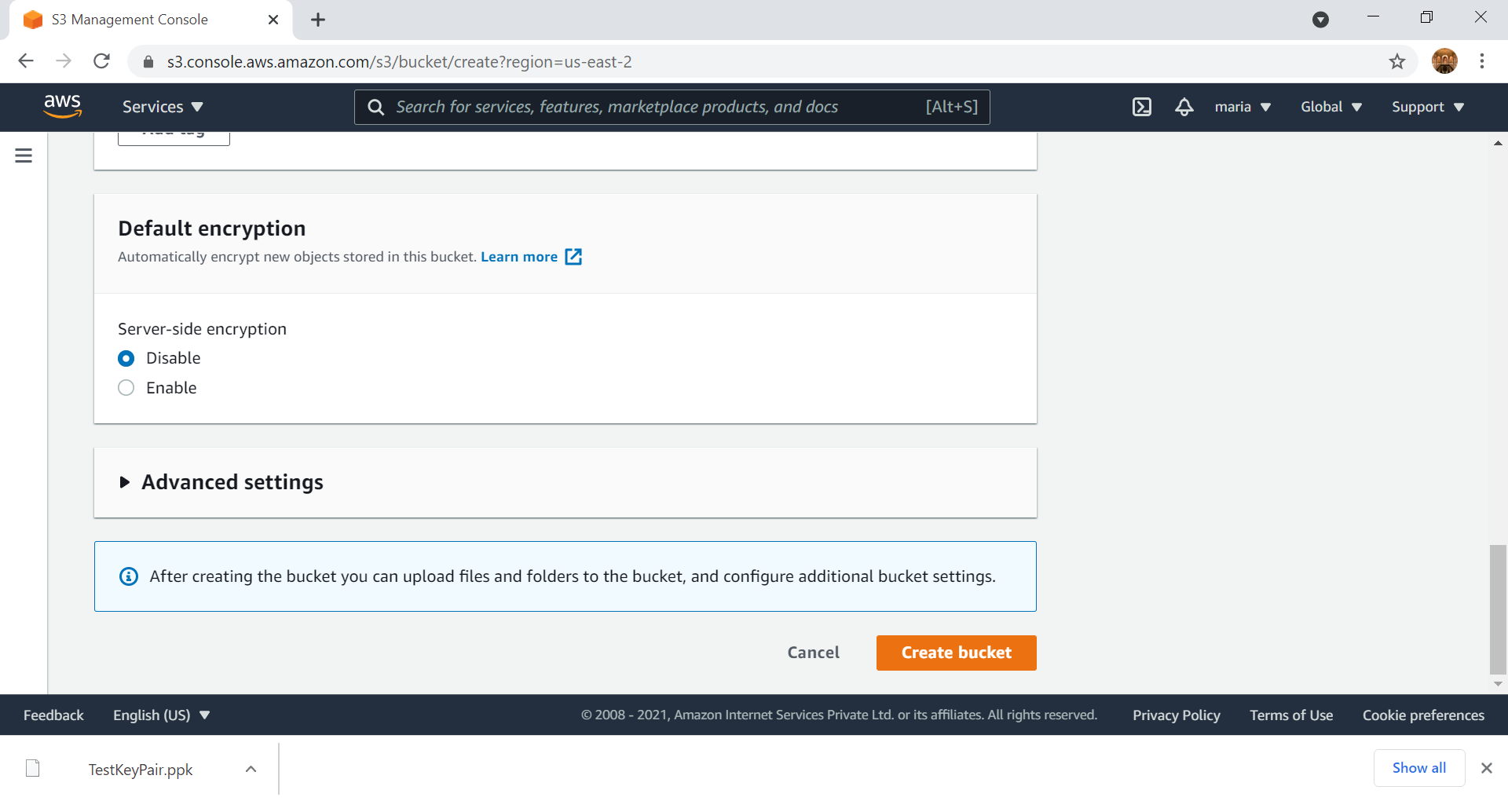
All other setting remain as default, no changes needs to be made

Slide 37
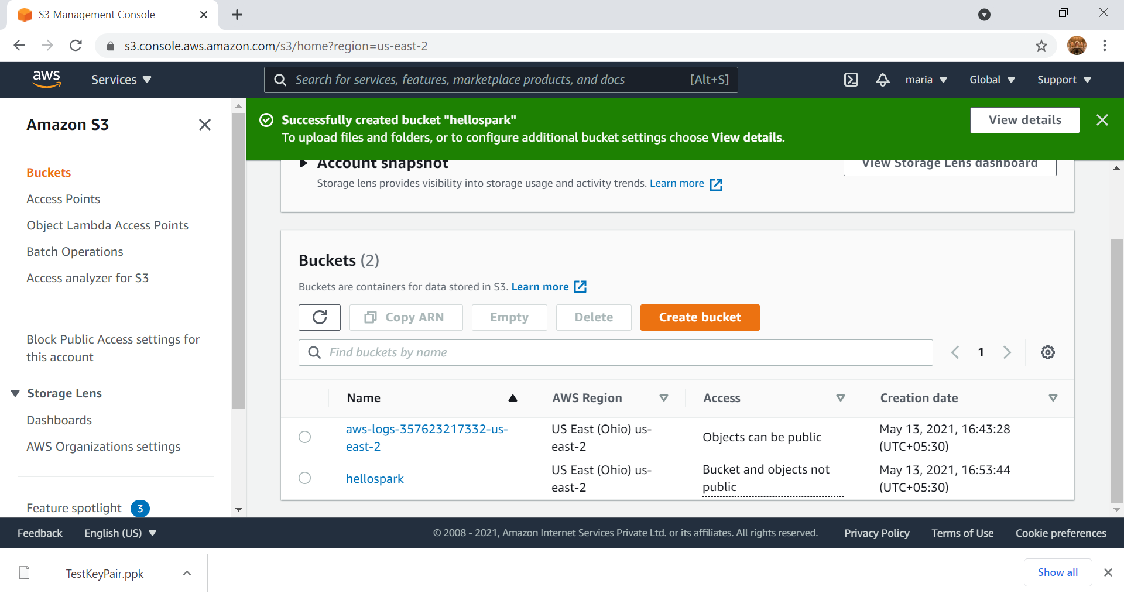
Select the folder

Slide 38
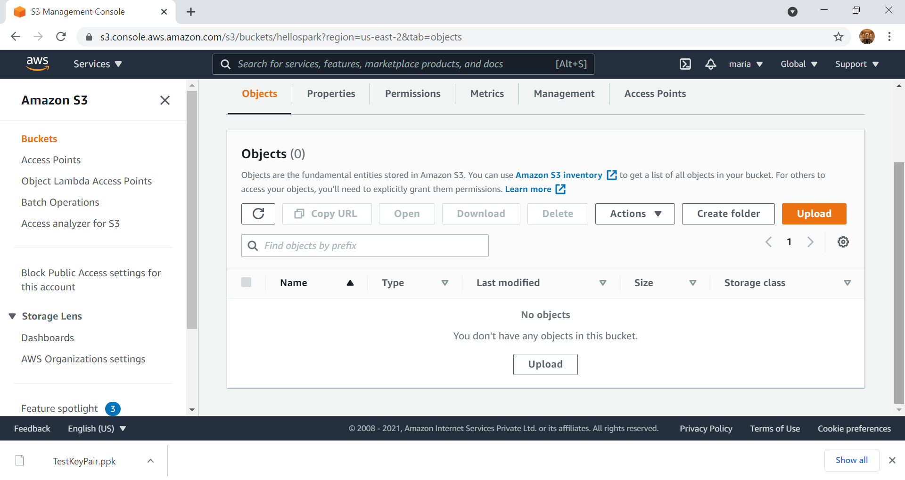

Slide 39
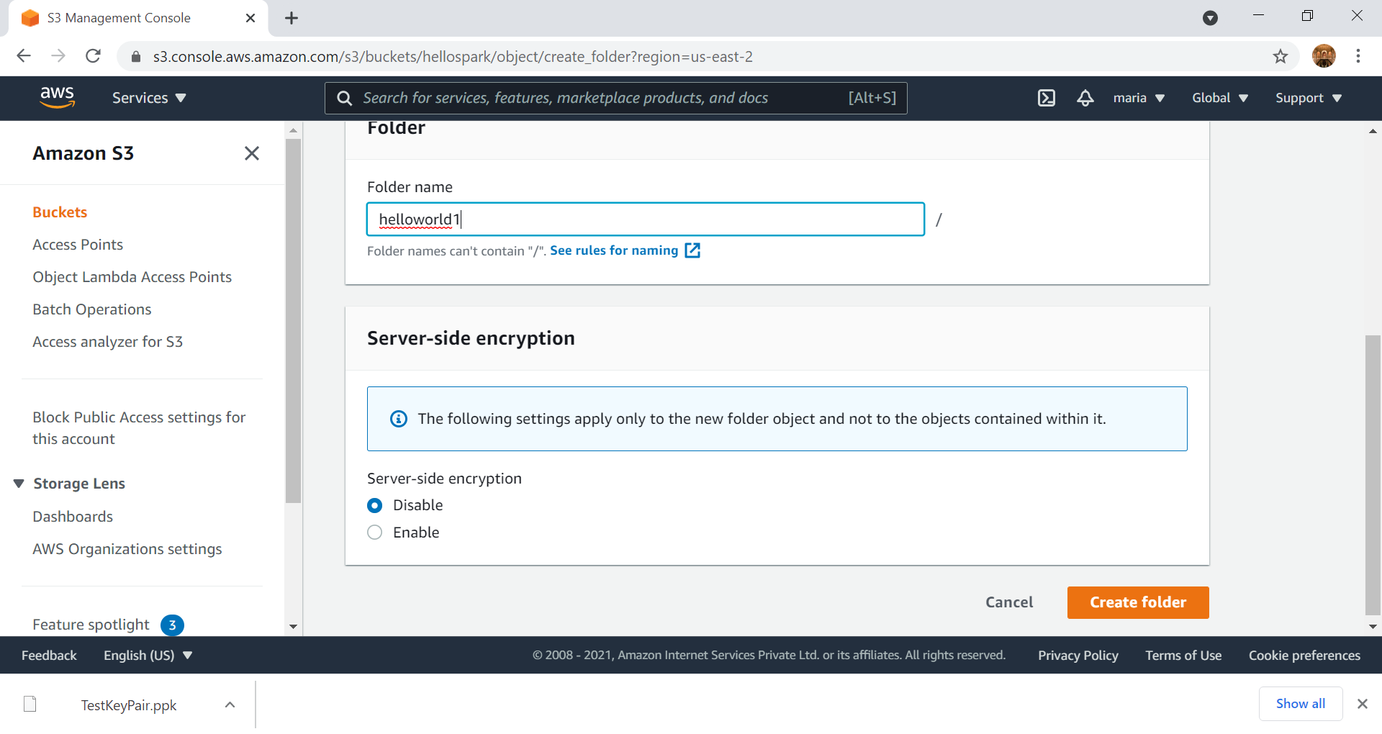

Slide 40
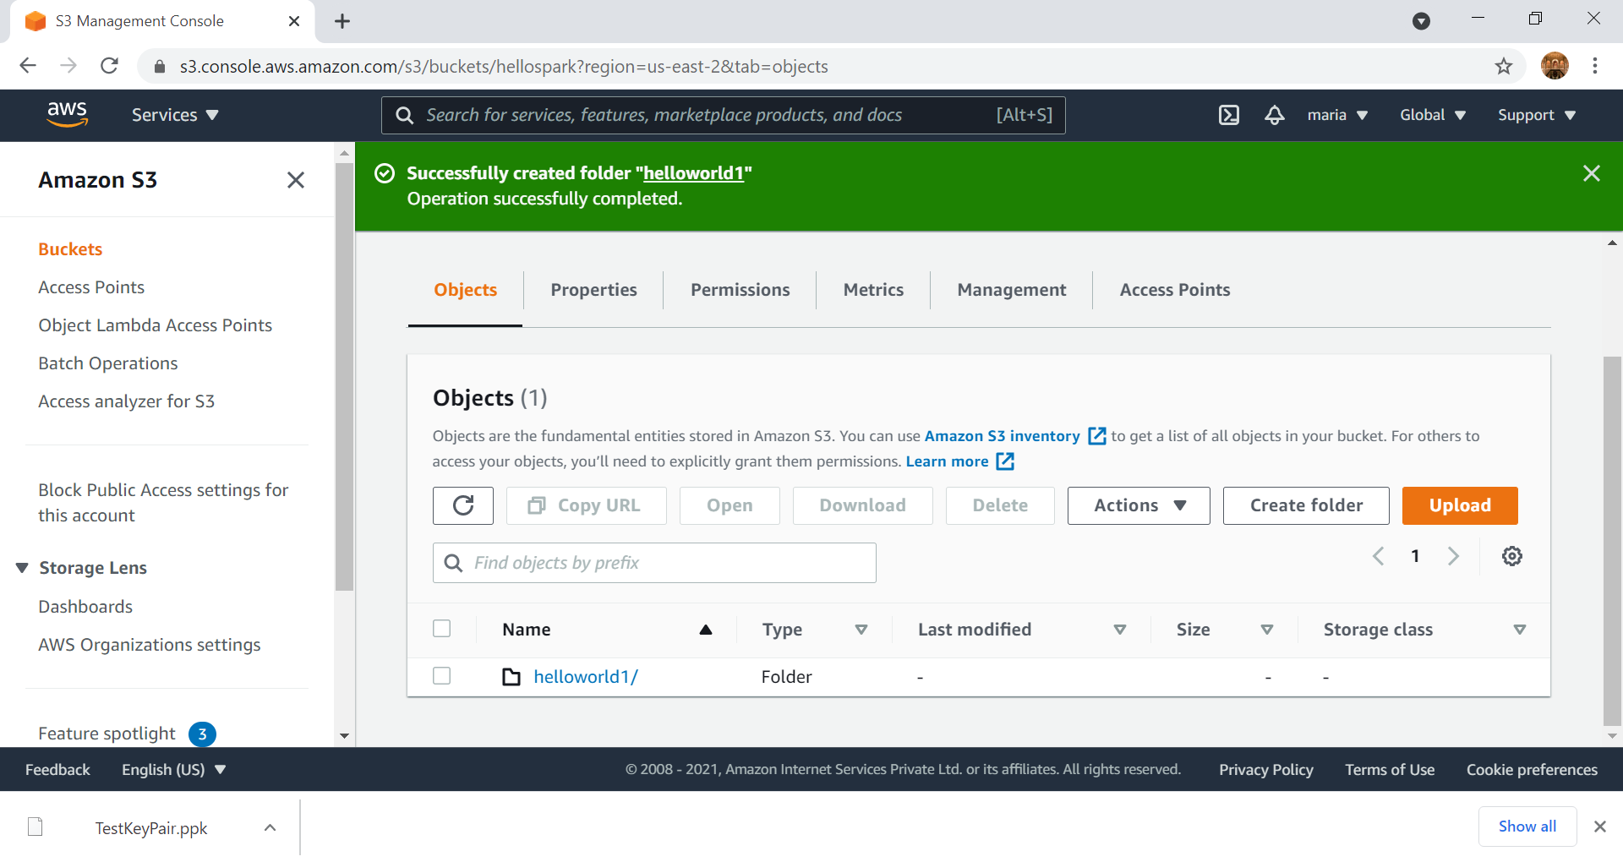
Select the folder

Slide 41
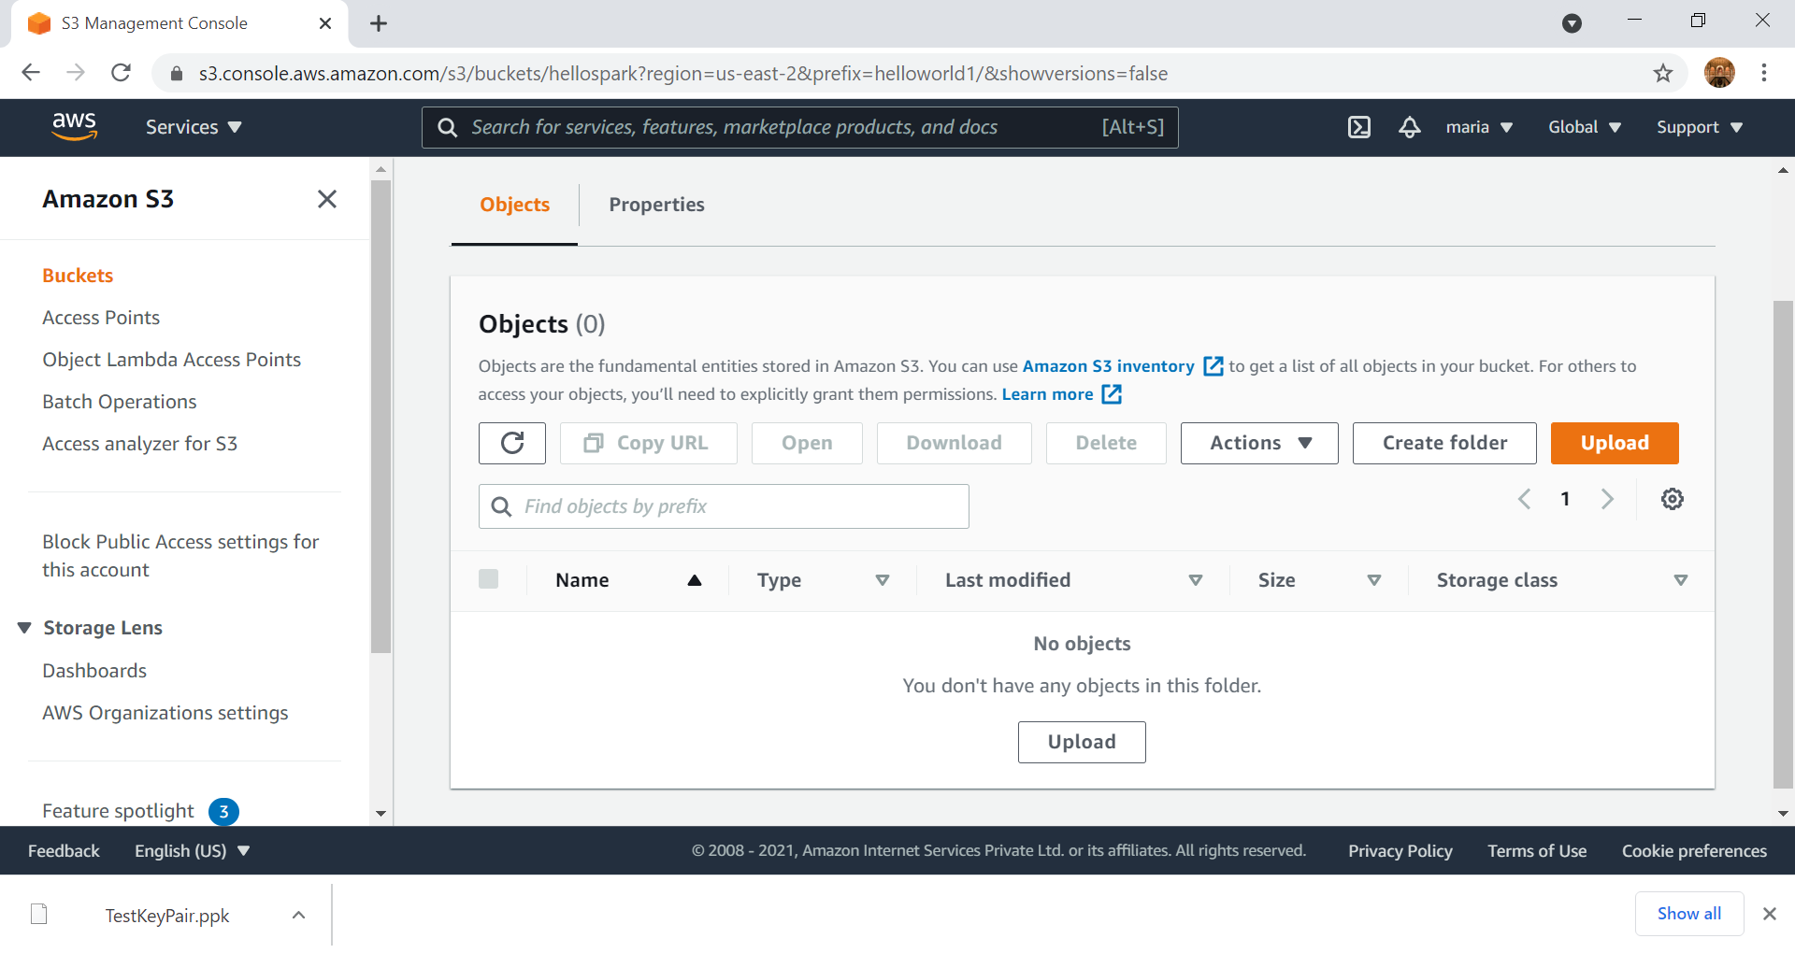

Slide 42
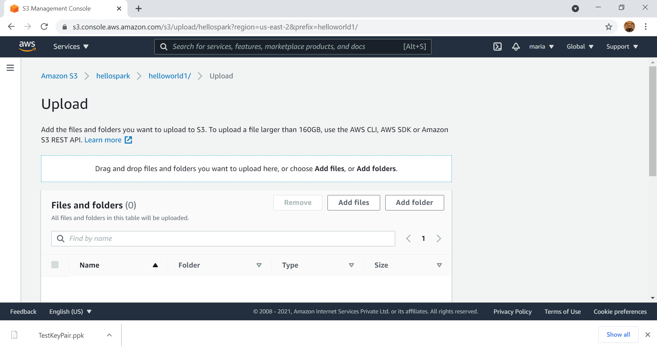

Slide 43
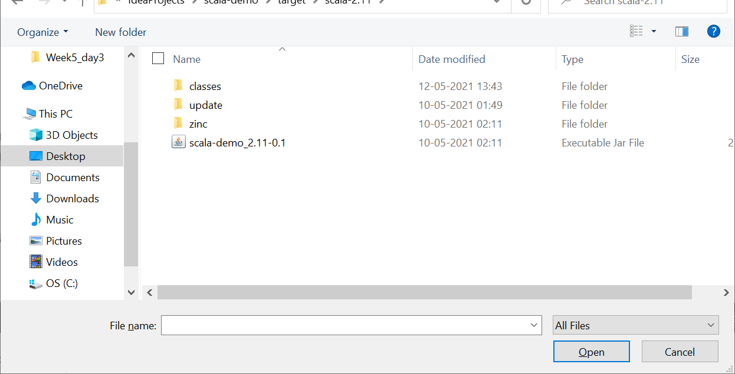
Select the location of the Jar file

Slide 44
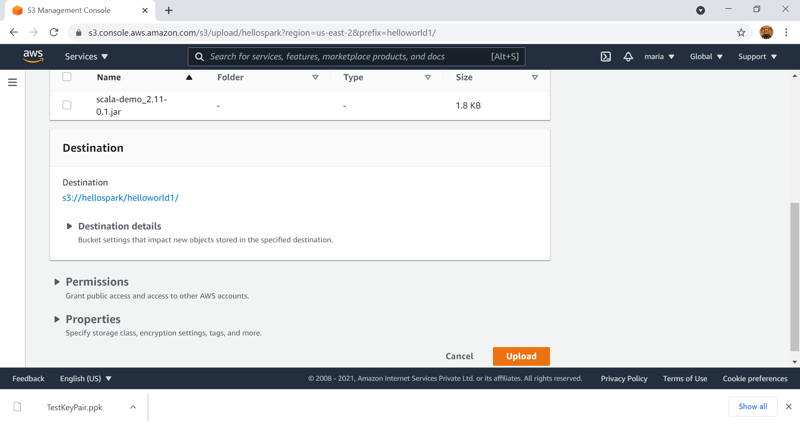

Slide 45
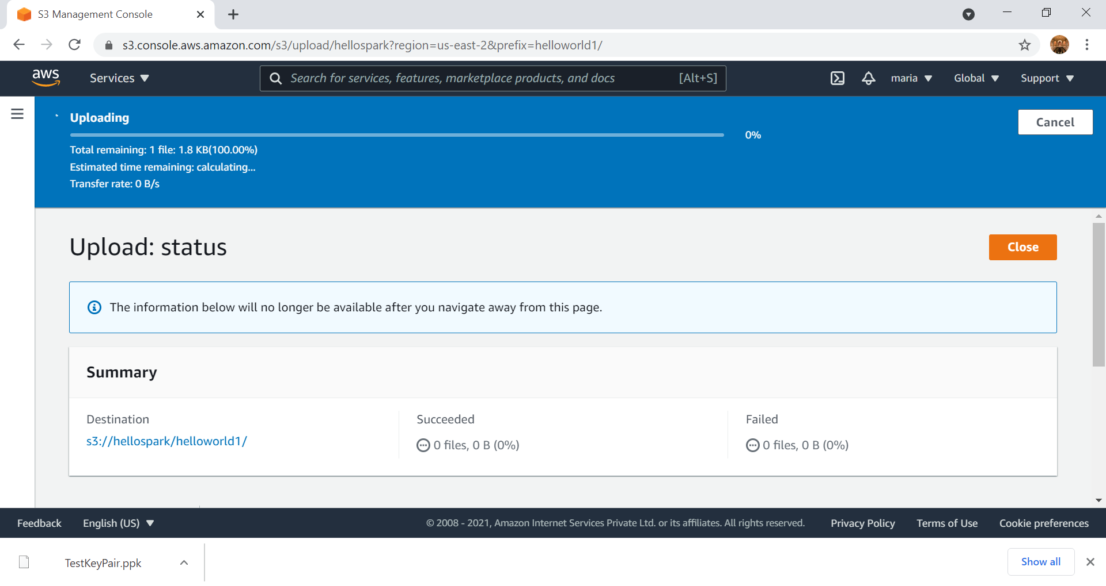

Slide 46
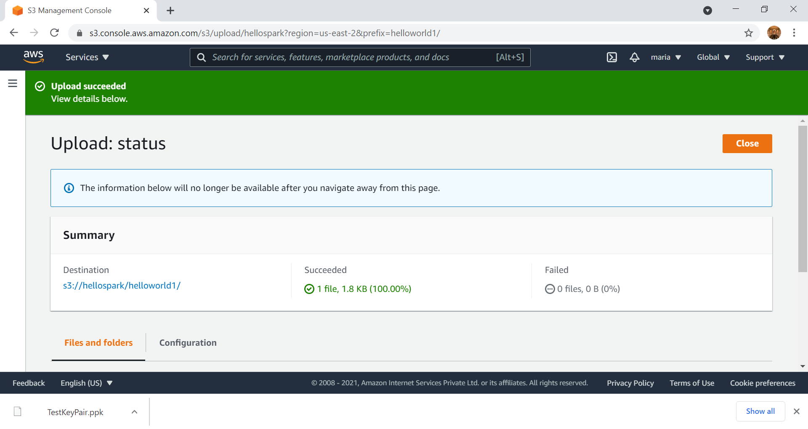

Slide 47
Go back to EMR

Slide 48
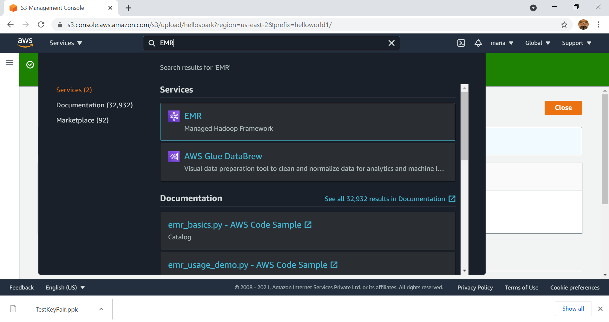

Slide 49
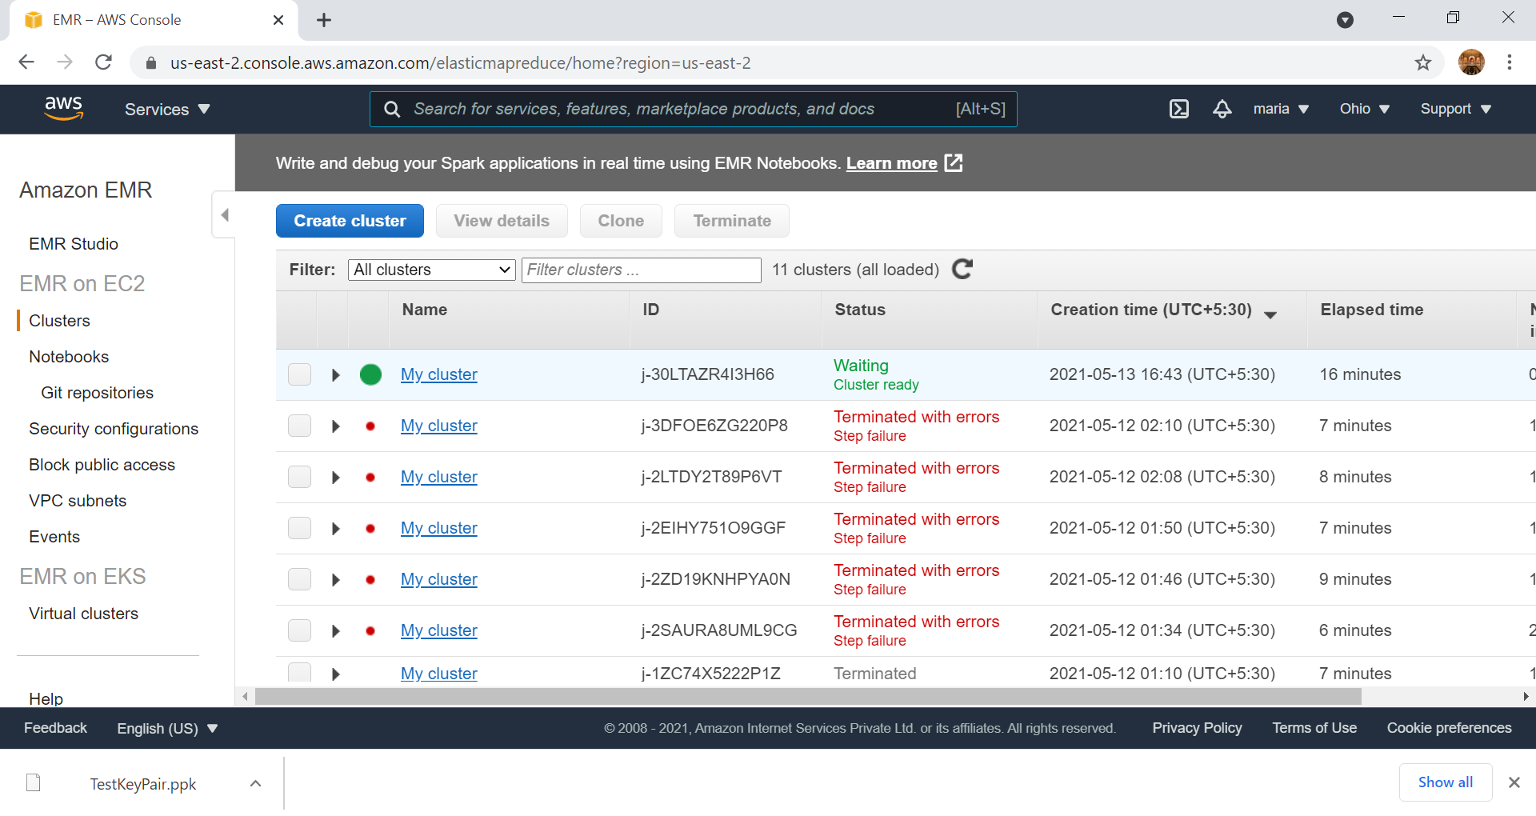

Slide 50
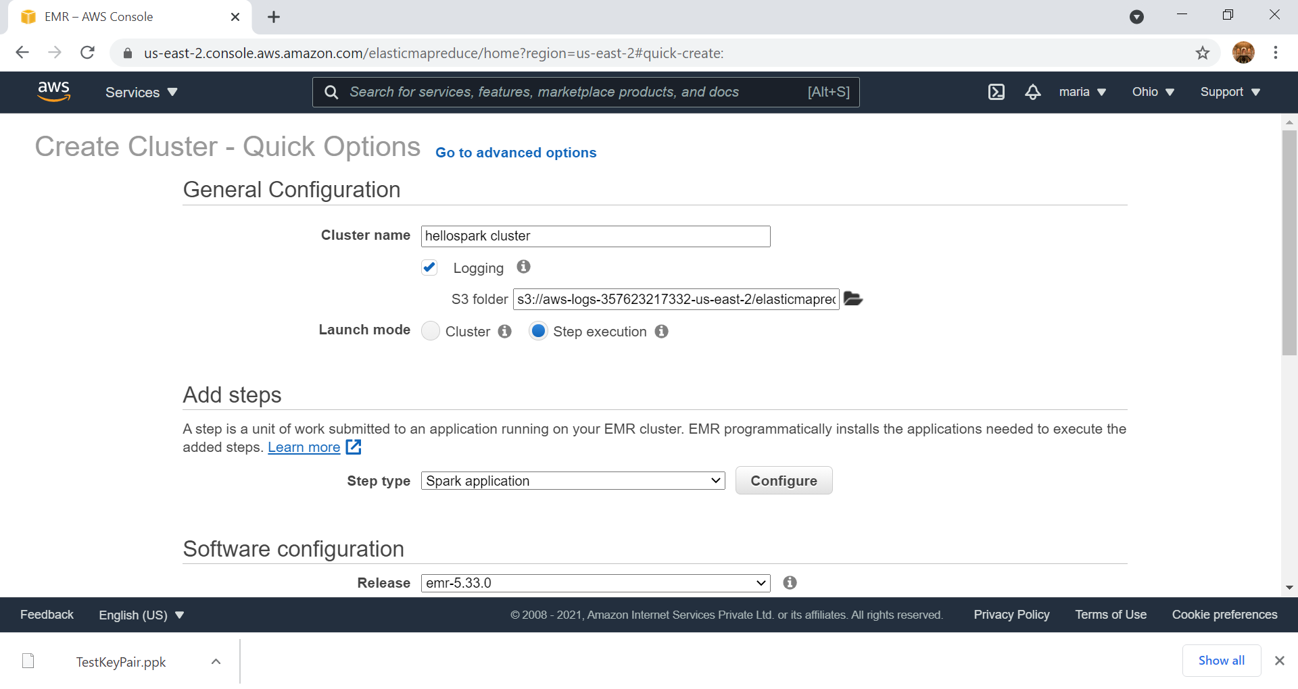
Click here to select the S3 bucket, where the Jar file is uploaded

Slide 51
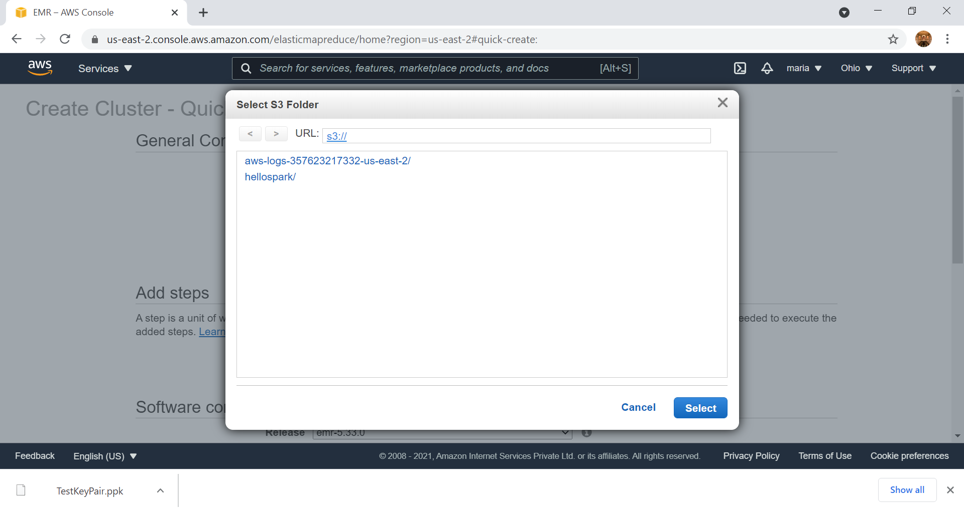

Slide 52
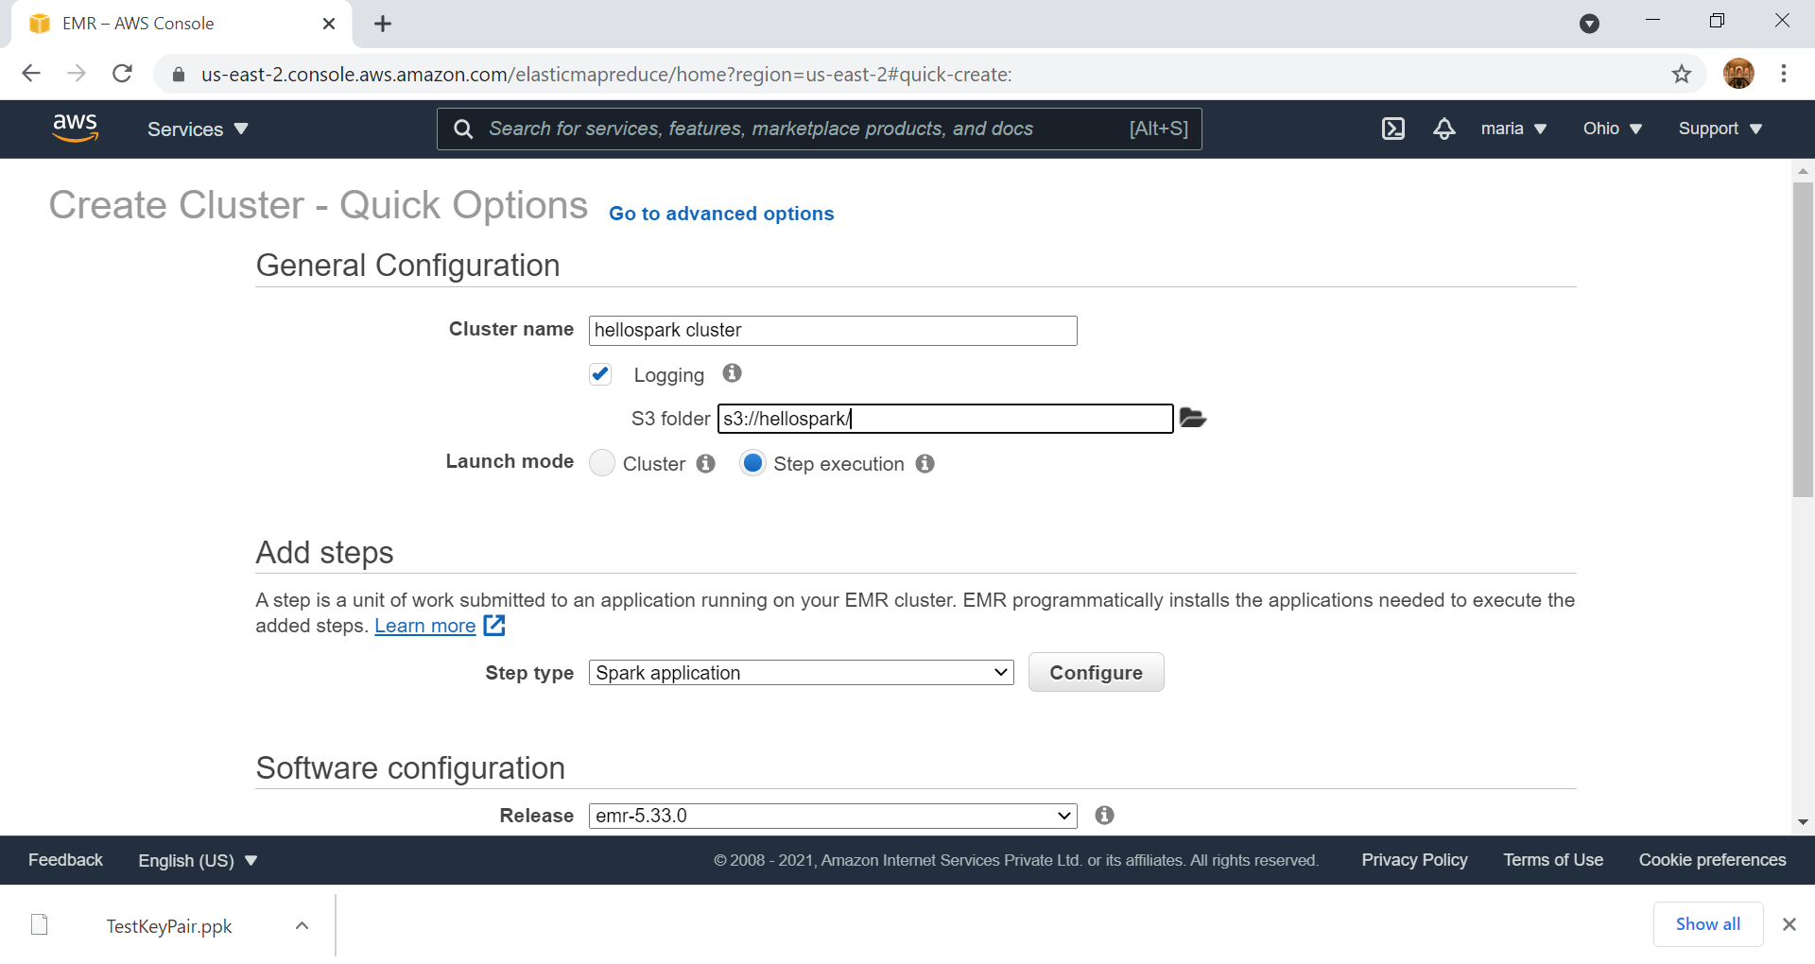
After selection, the bucket location is seen

Slide 53
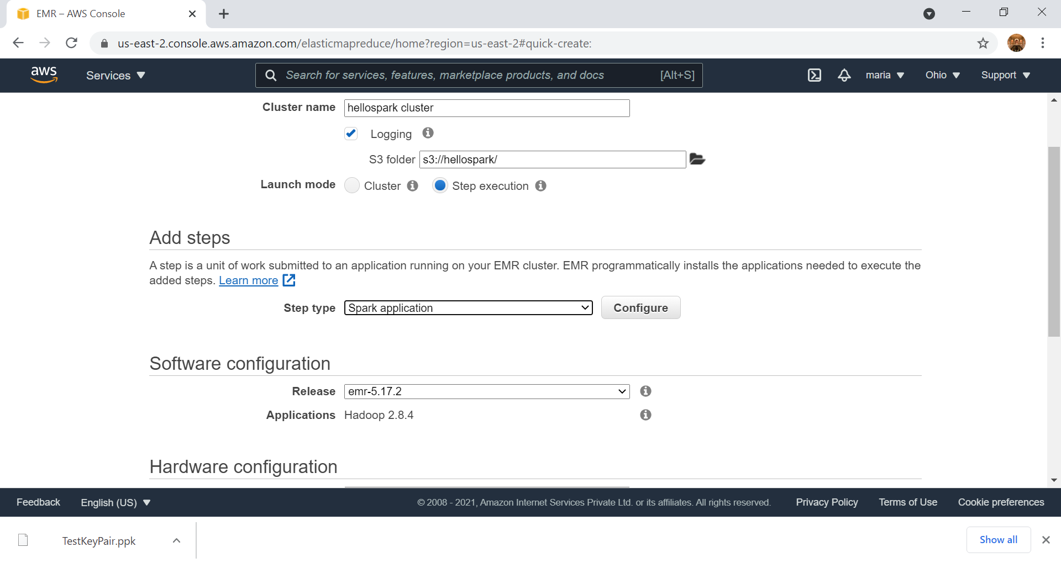
EMR release can be changed based on the spark version used in the built.sbt file of the program

Slide 54
Click on Configure

Slide 55
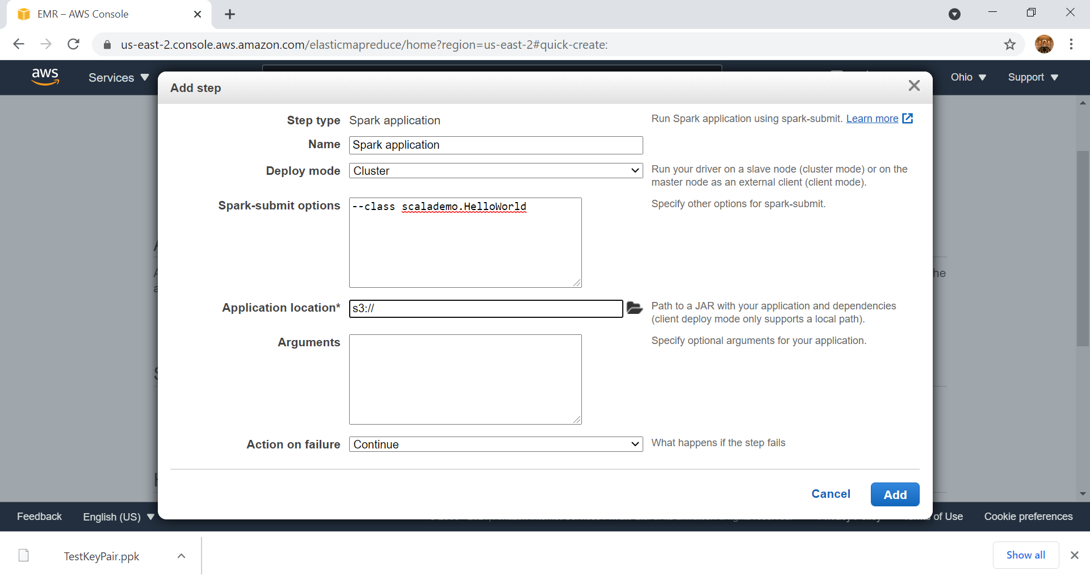
Enter the class, as per the program
--class scalademo.HelloWorld
Package = scalademo
Object - HelloWorld
After entering the class, click on this link to select the location of the Jar

Slide 56
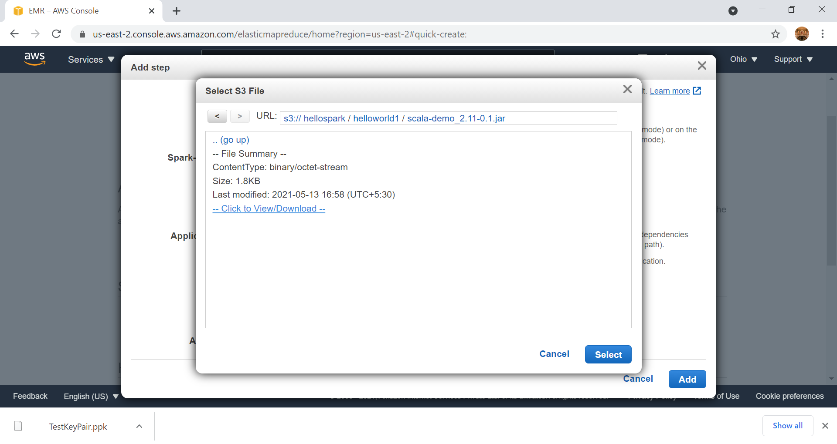

Slide 57
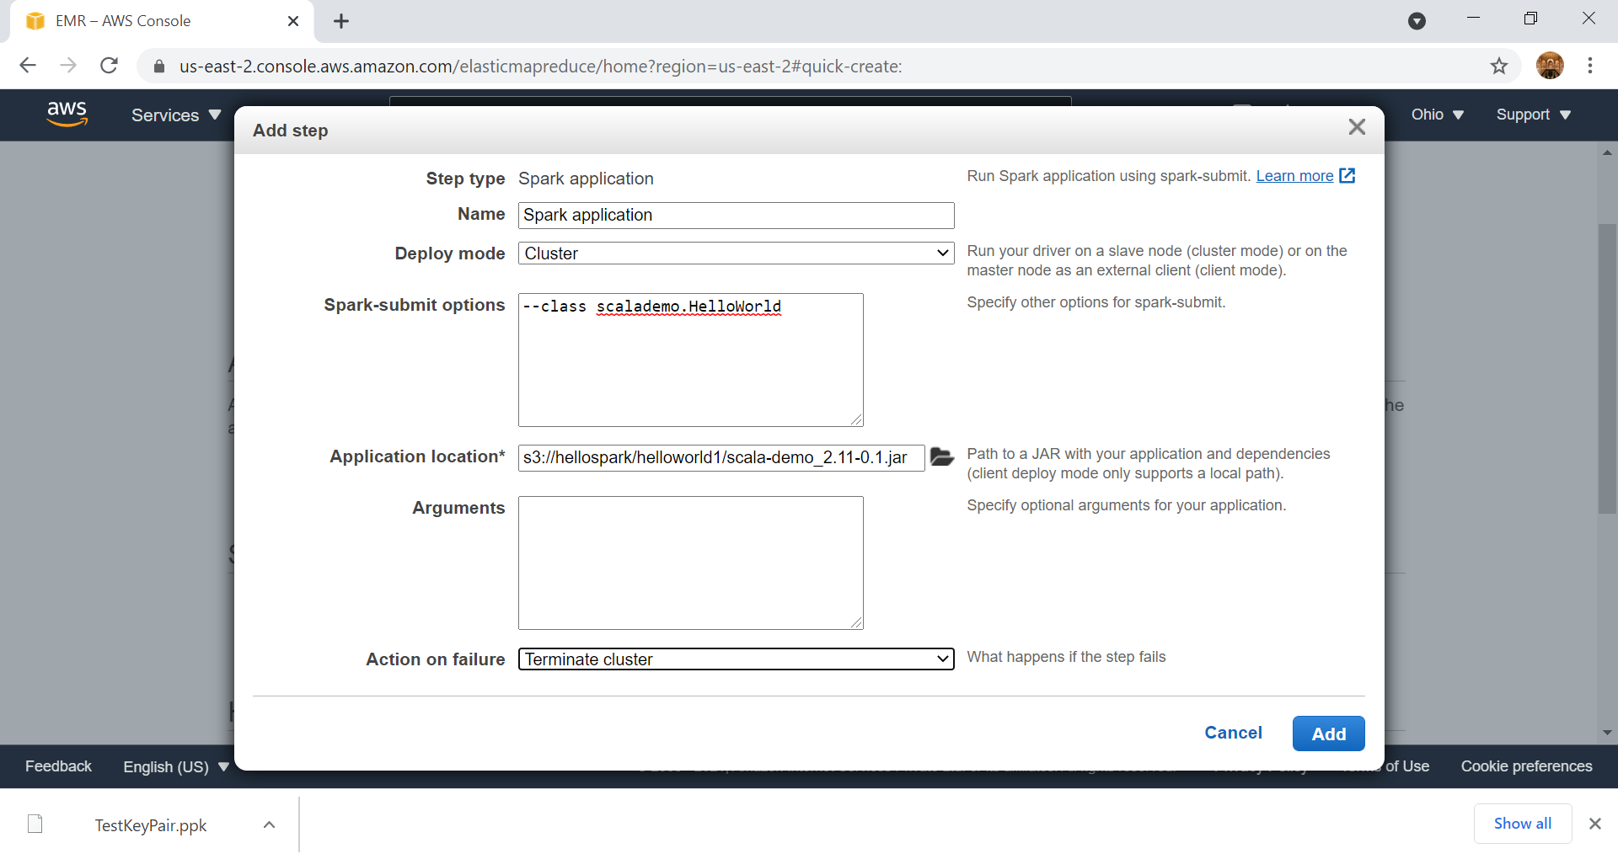

Slide 58
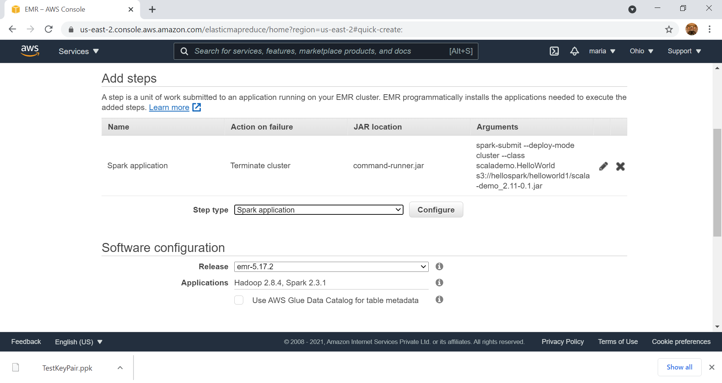

Slide 59
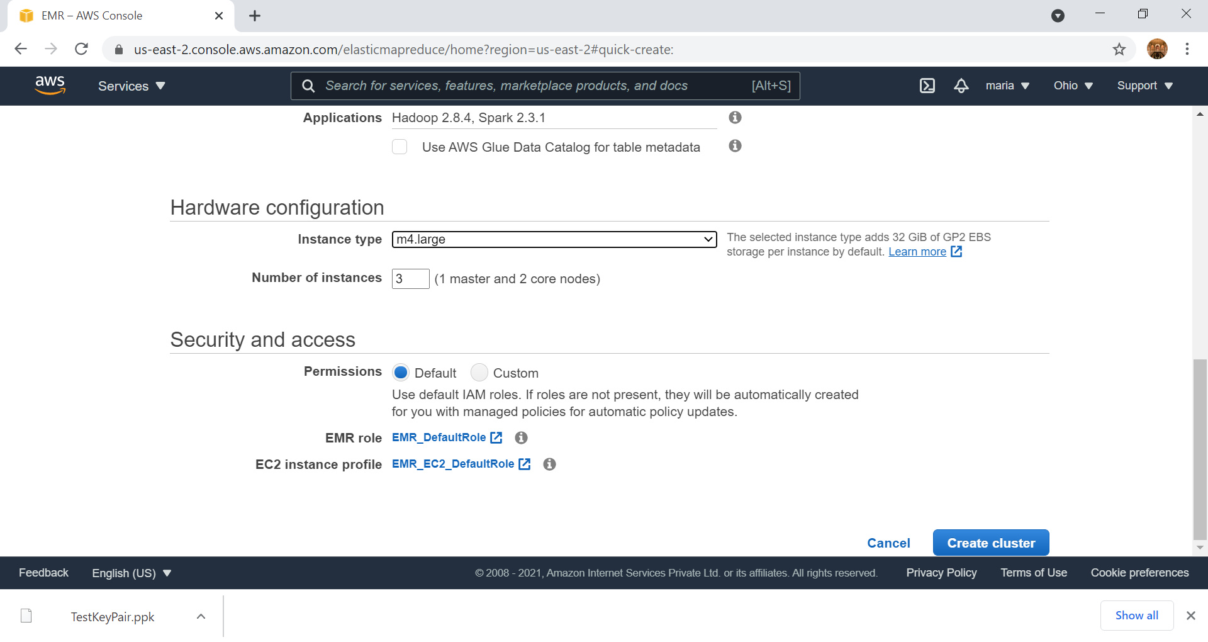

Slide 60
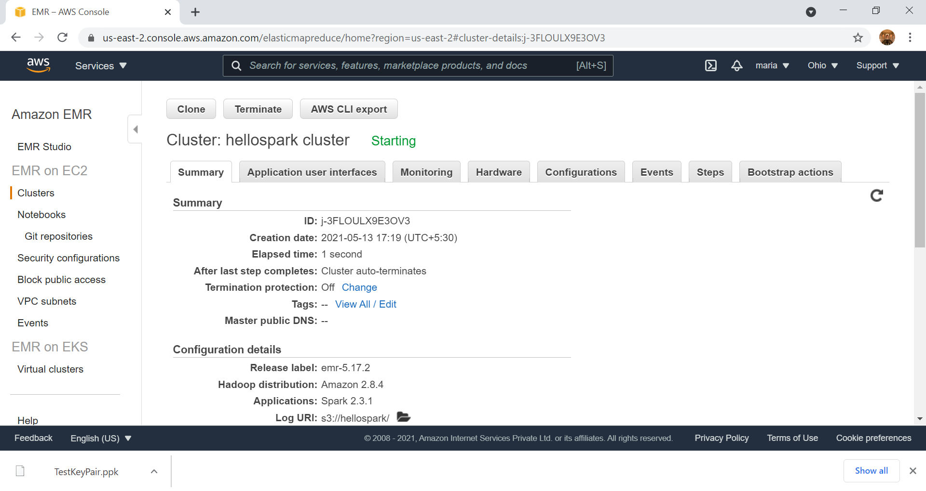

Slide 61
Starting – Running - Terminating
Click on the refresh icon to see the status passing from Starting to Running to Terminating — All steps completed
It will take about 10 mins to reach the terminating stage

Slide 62


Slide 63

Click here to find the output file

Slide 64


Slide 65


Slide 66


Slide 67


Slide 68


Slide 69


Slide 70
Delete S3 – Important Step to save Cost

Slide 71


Slide 72


Slide 73


Slide 74


Slide 75


Slide 76


Slide 77

Delete all the buckets one by one

Slide 78


Slide 79


Slide 80

No Buckets after deleting all the Buckets, Folders and Files

Slide 81
Ensure all EMR Clusters are Terminated

Slide 82

All the Cluster are in ‘Terminated’ status

Slide 83


Signout of AWS

Slide 84

Hope You Enjoyed Working on AWS EMR Cluster Thank You

